Slide 1
Introduction to Java Applications
Java™ How to Program, 9/e

Slide 2
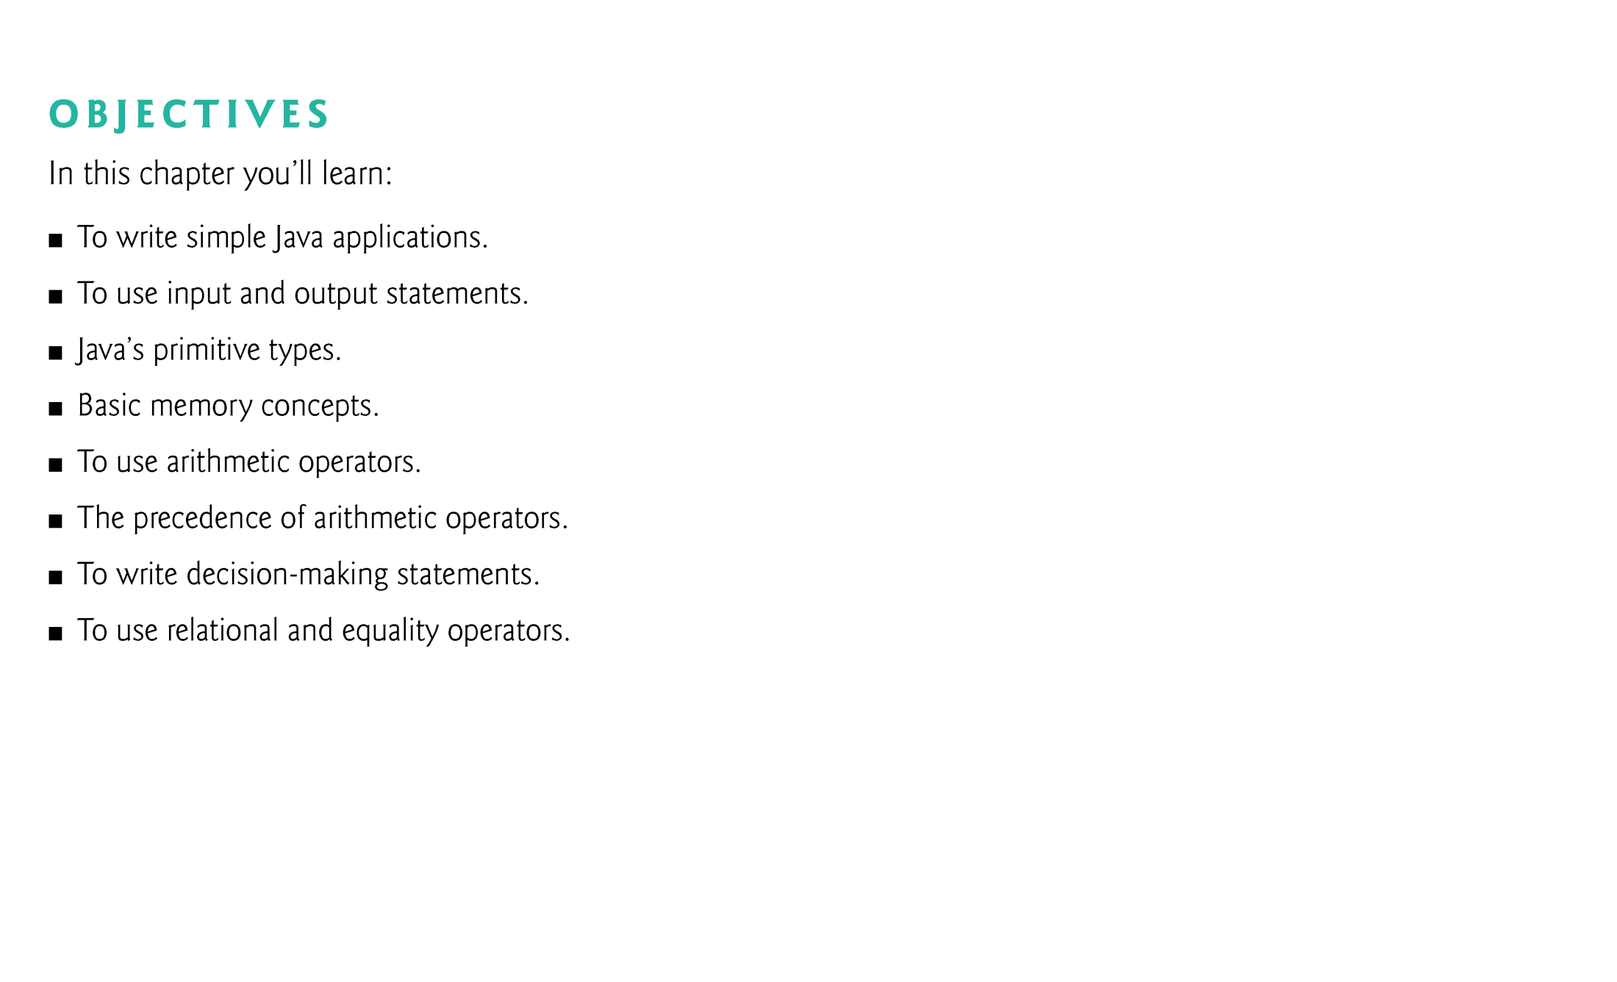

Slide 3
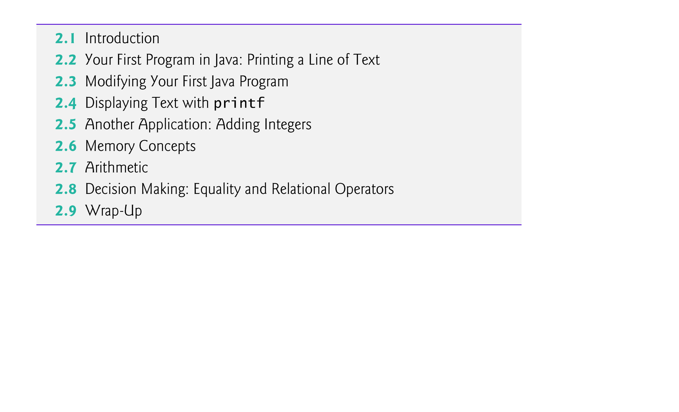

Slide 4
2.1 Introduction
Java application programming
Use tools from the JDK to compile and run programs.
Videos at www.deitel.com/books/jhtp9/
Help you get started with Eclipse and NetBeans integrated development environments.

Slide 5
2.2 Our First Program in Java: Printing a Line of Text
Java application
A computer program that executes when you use the java command to launch the Java Virtual Machine (JVM).
Sample program in Fig. 2.1 displays a line of text.

Slide 6
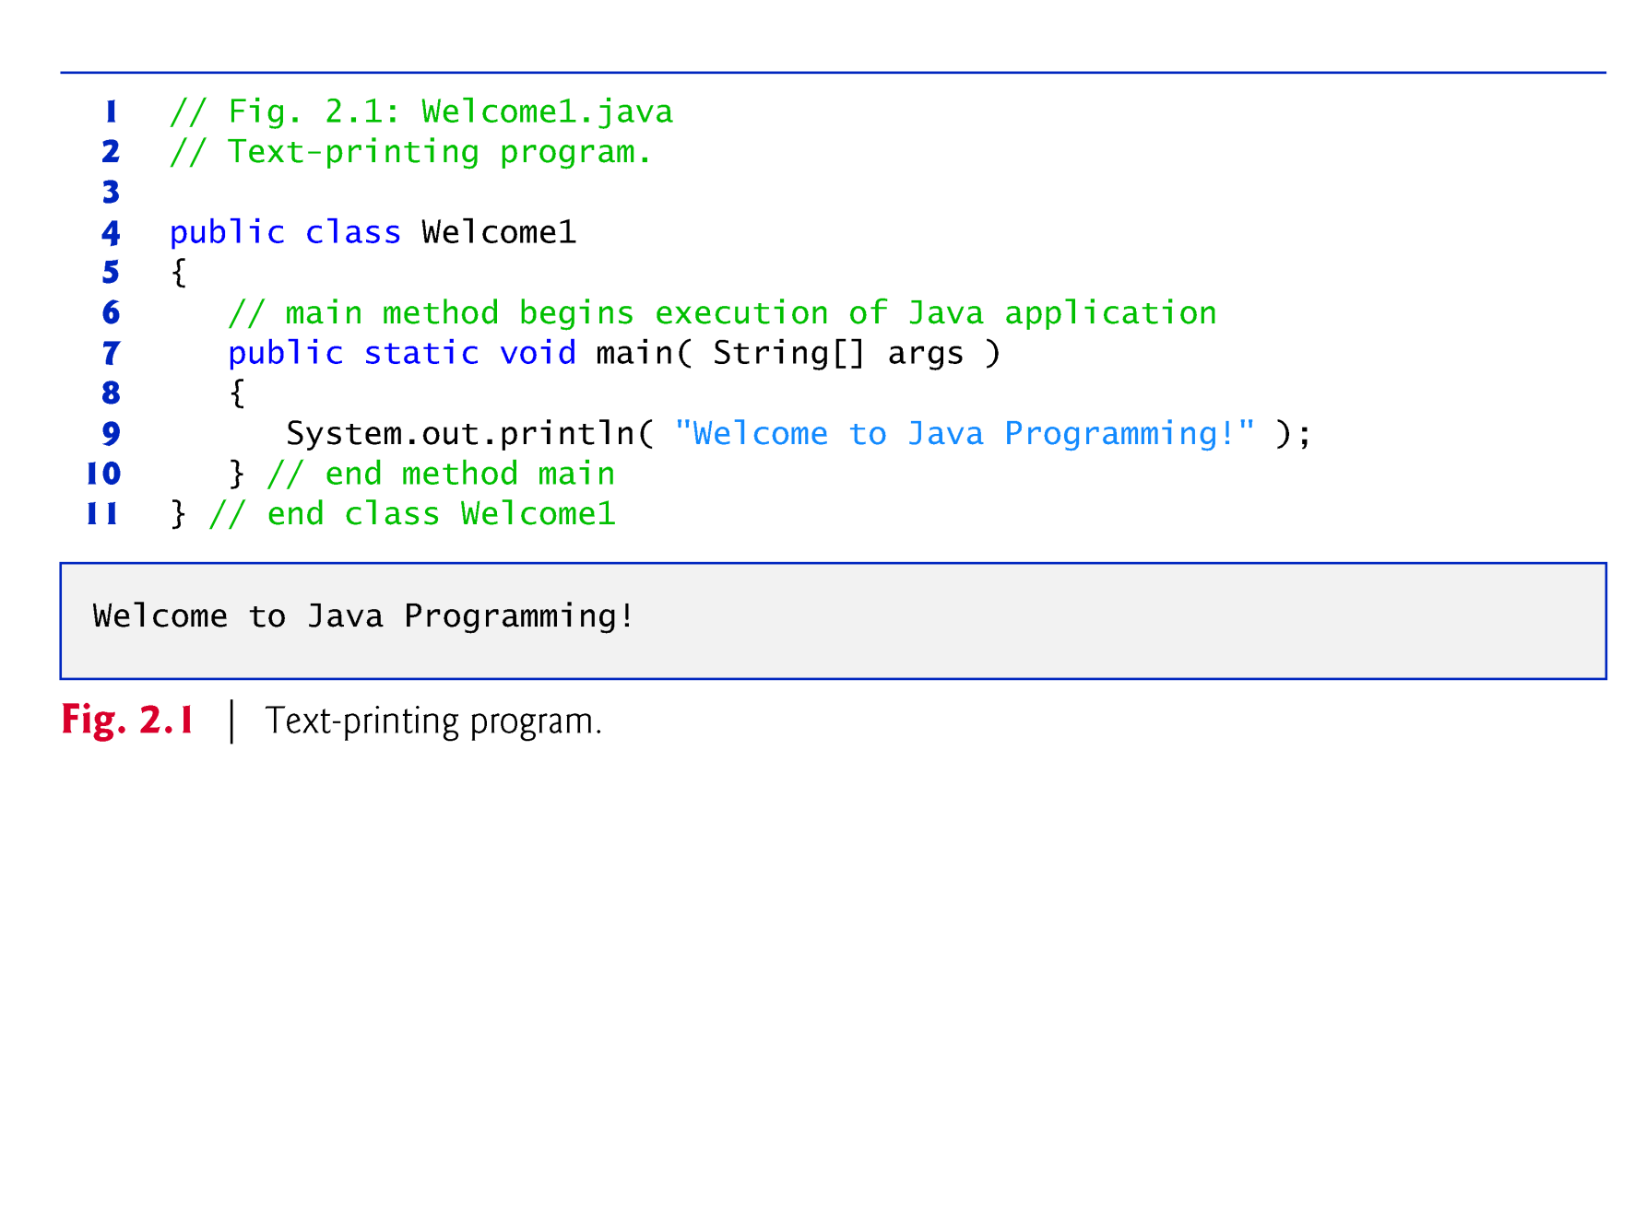

Slide 7
2.2 Our First Program in Java: Printing a Line of Text (Cont.)
Comments
// Fig. 2.1: Welcome1.java
// indicates that the line is a comment.
Used to document programs and improve their readability.
Compiler ignores comments.
A comment that begins with // is an end-of-line comment—it terminates at the end of the line on which it appears.
Traditional comment, can be spread over several lines as in
/* This is a traditional comment. It can be split over multiple lines */
This type of comment begins with /* and ends with */.
All text between the delimiters is ignored by the compiler.

Slide 8
2.2 Our First Program in Java: Printing a Line of Text (Cont.)
Javadoc comments
Delimited by /** and */.
All text between the Javadoc comment delimiters is ignored by the compiler.
Enable you to embed program documentation directly in your programs.
The javadoc utility program (Appendix M) reads Javadoc comments and uses them to prepare your program’s documentation in HTML format.

Slide 9
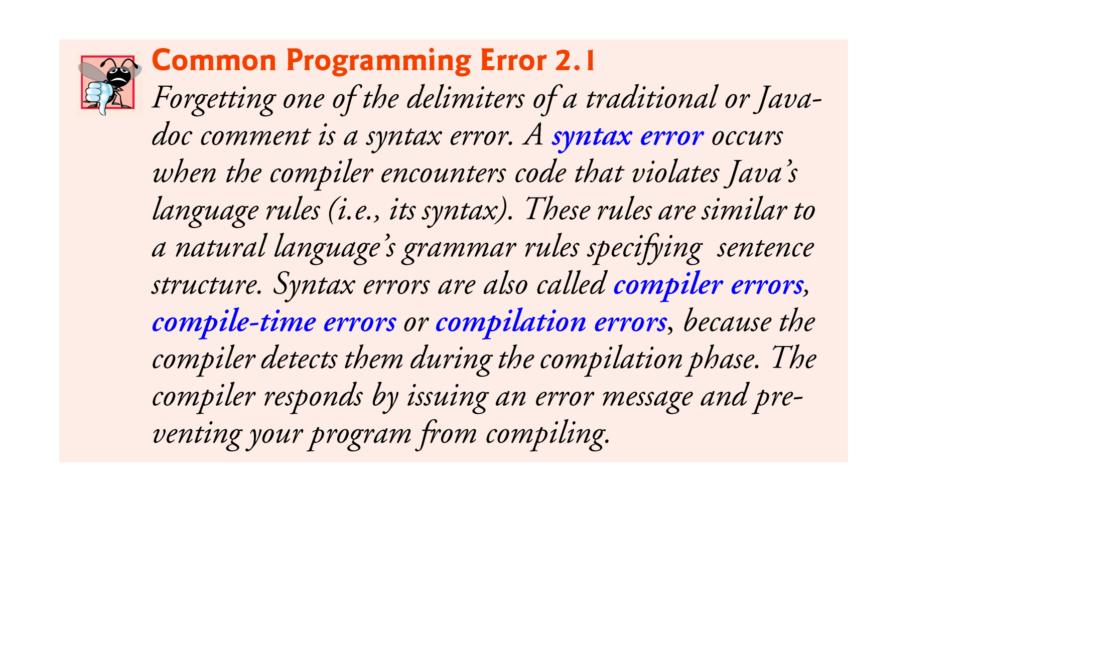

Slide 10
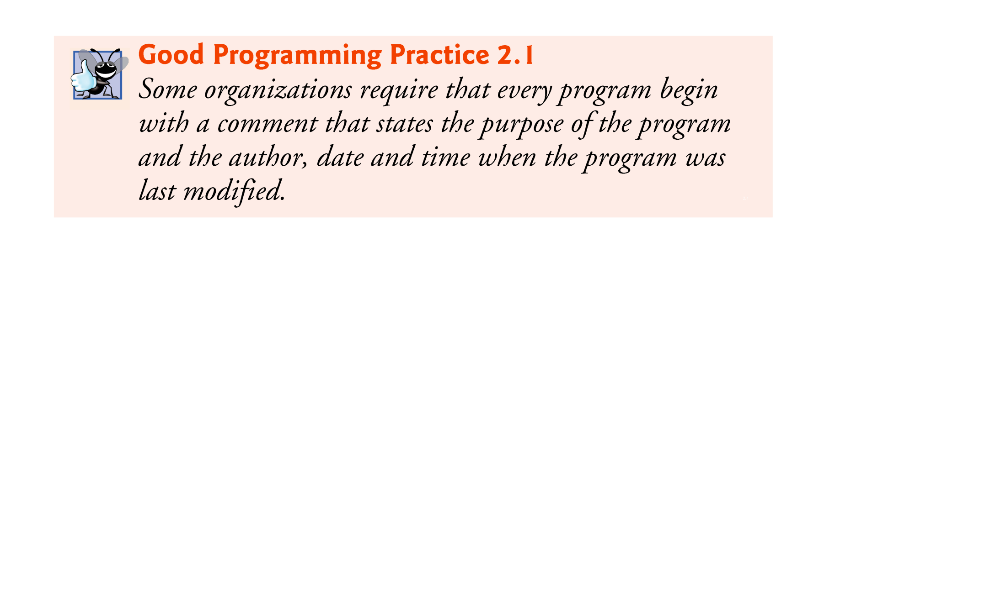

Slide 11
2.2 Our First Program in Java: Printing a Line of Text (Cont.)
Blank lines and space characters
Make programs easier to read.
Blank lines, spaces and tabs are known as white space (or whitespace).
White space is ignored by the compiler.

Slide 12
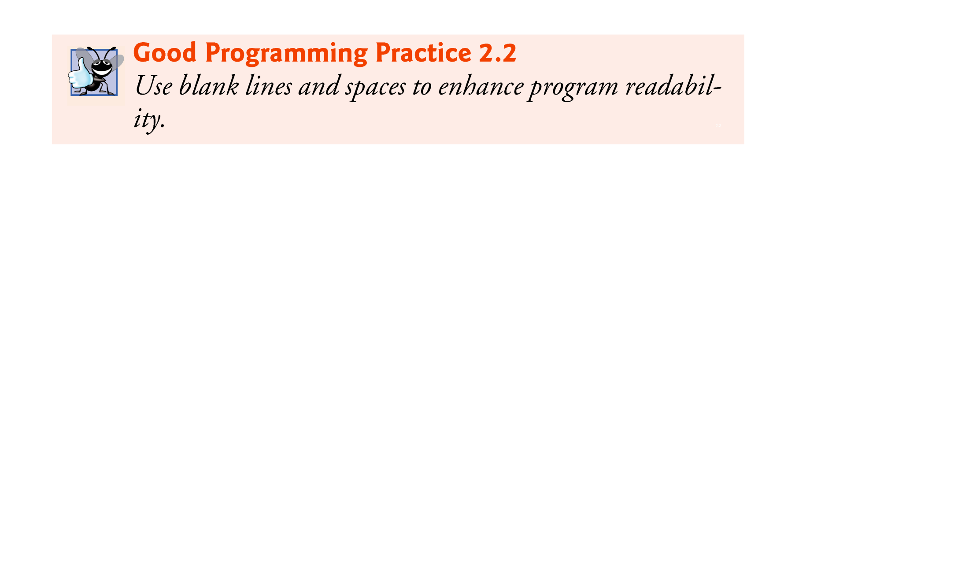

Slide 13
2.2 Our First Program in Java: Printing a Line of Text (Cont.)
Class declaration
public class Welcome1
Every Java program consists of at least one class that you define.
class keyword introduces a class declaration and is immediately followed by the class name.
Keywords (Appendix C) are reserved for use by Java and are always spelled with all lowercase letters.

Slide 14
2.2 Our First Program in Java: Printing a Line of Text (Cont.)
Class names
By convention, begin with a capital letter and capitalize the first letter of each word they include (e.g., SampleClassName).
A class name is an identifier—a series of characters consisting of letters, digits, underscores (_) and dollar signs ($) that does not begin with a digit and does not contain spaces.
Java is case sensitive—uppercase and lowercase letters are distinct—so a1 and A1 are different (but both valid) identifiers.

Slide 15
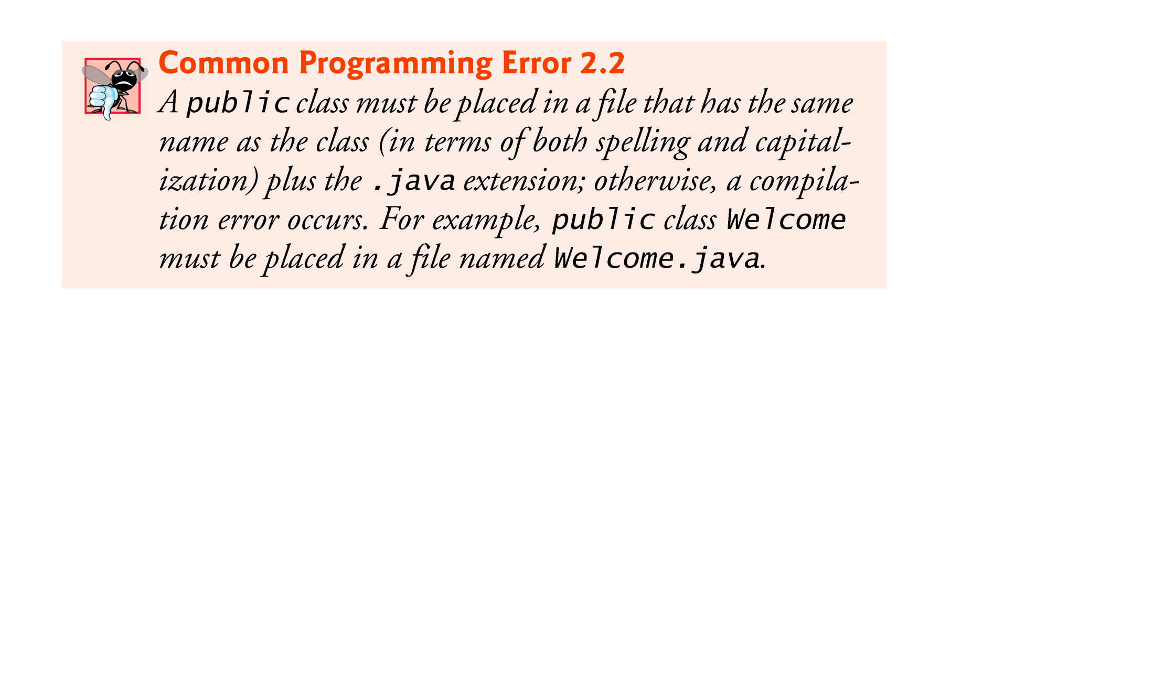

Slide 16
2.2 Our First Program in Java: Printing a Line of Text (Cont.)
Braces
A left brace, {, begins the body of every class declaration.
A corresponding right brace, }, must end each class declaration.
Code between braces should be indented.
This indentation is one of the spacing conventions mentioned earlier.

Slide 17
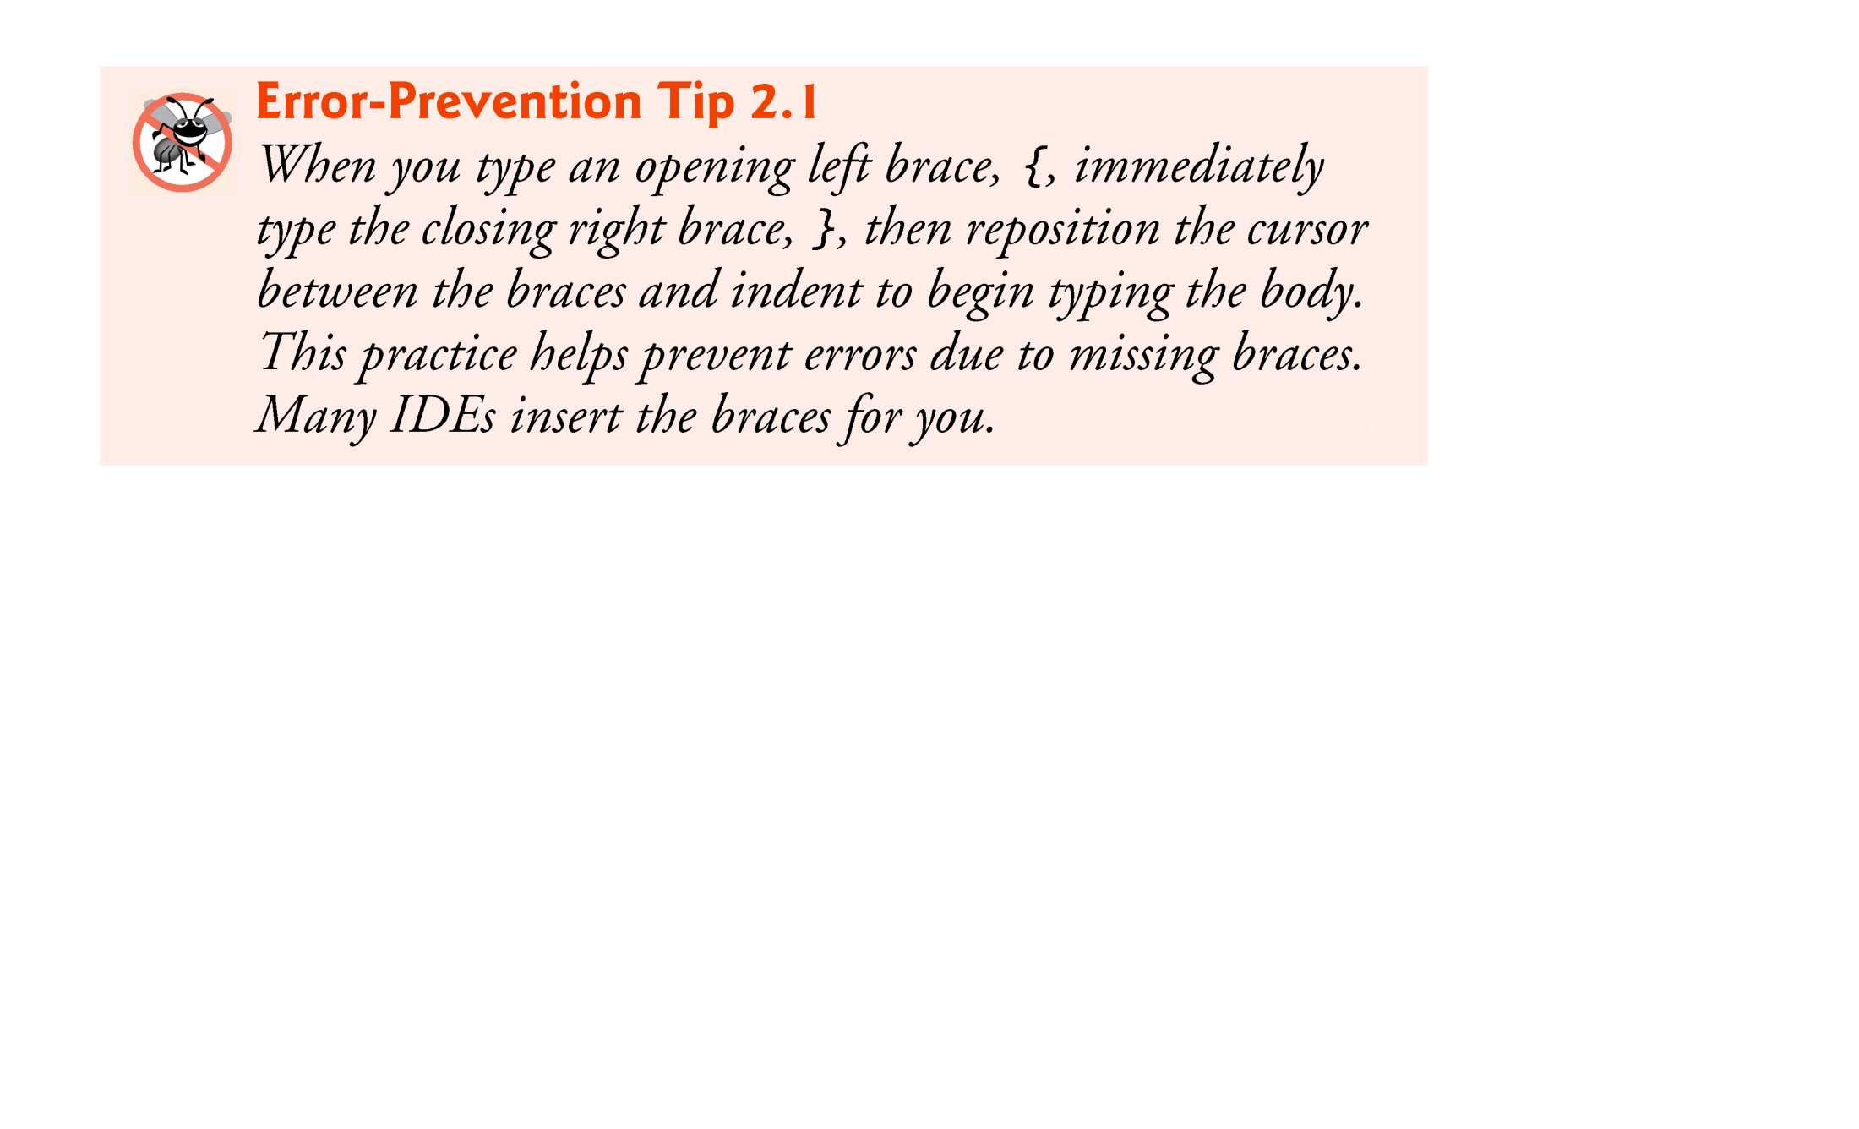

Slide 18


Slide 19


Slide 20


Slide 21
2.2 Our First Program in Java: Printing a Line of Text (Cont.)
Declaring the main Method
public static void main( String[] args )
Starting point of every Java application.
Parentheses after the identifier main indicate that it’s a program building block called a method.
Java class declarations normally contain one or more methods.
main must be defined as shown; otherwise, the JVM will not execute the application.
Methods perform tasks and can return information when they complete their tasks.
Keyword void indicates that this method will not return any information.

Slide 22
2.2 Our First Program in Java: Printing a Line of Text (Cont.)
Body of the method declaration
Enclosed in left and right braces.
Statement
System.out.println("Welcome to Java Programming!");
Instructs the computer to perform an action
Print the string of characters contained between the double quotation marks.
A string is sometimes called a character string or a string literal.
White-space characters in strings are not ignored by the compiler.
Strings cannot span multiple lines of code.

Slide 23
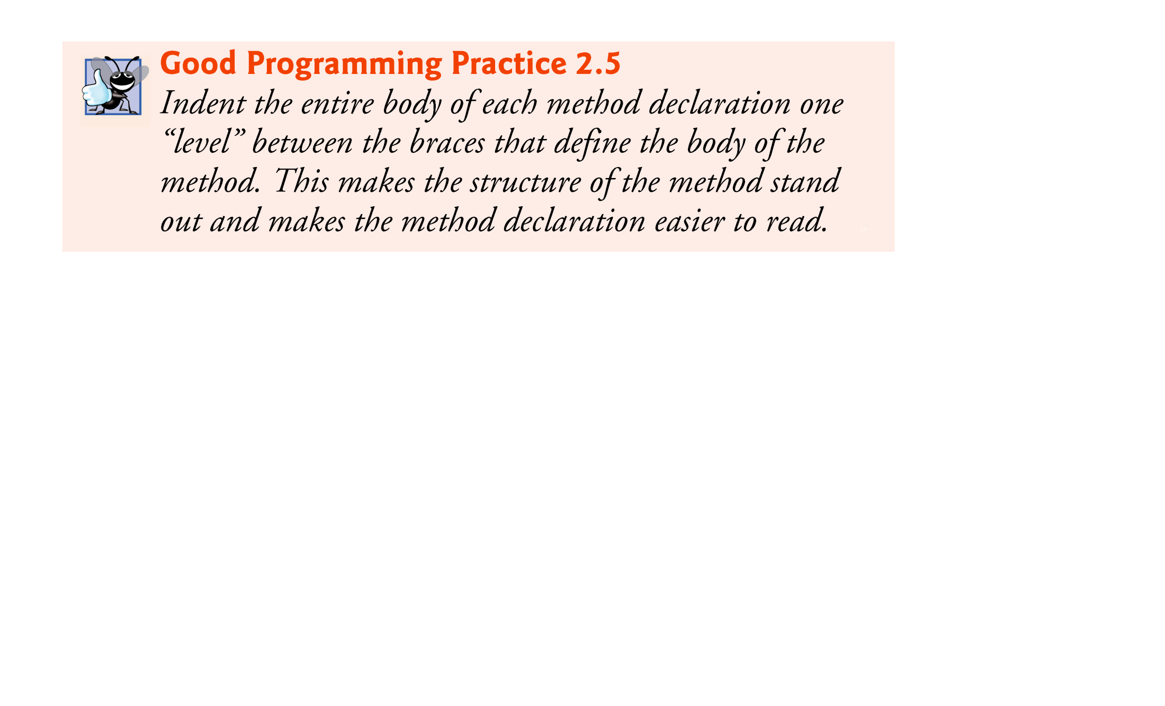

Slide 24
2.2 Our First Program in Java: Printing a Line of Text (Cont.)
System.out object
Standard output object.
Allows Java applications to display strings in the command window from which the Java application executes.
System.out.println method
Displays (or prints) a line of text in the command window.
The string in the parentheses the argument to the method.
Positions the output cursor at the beginning of the next line in the command window.
Most statements end with a semicolon.

Slide 25
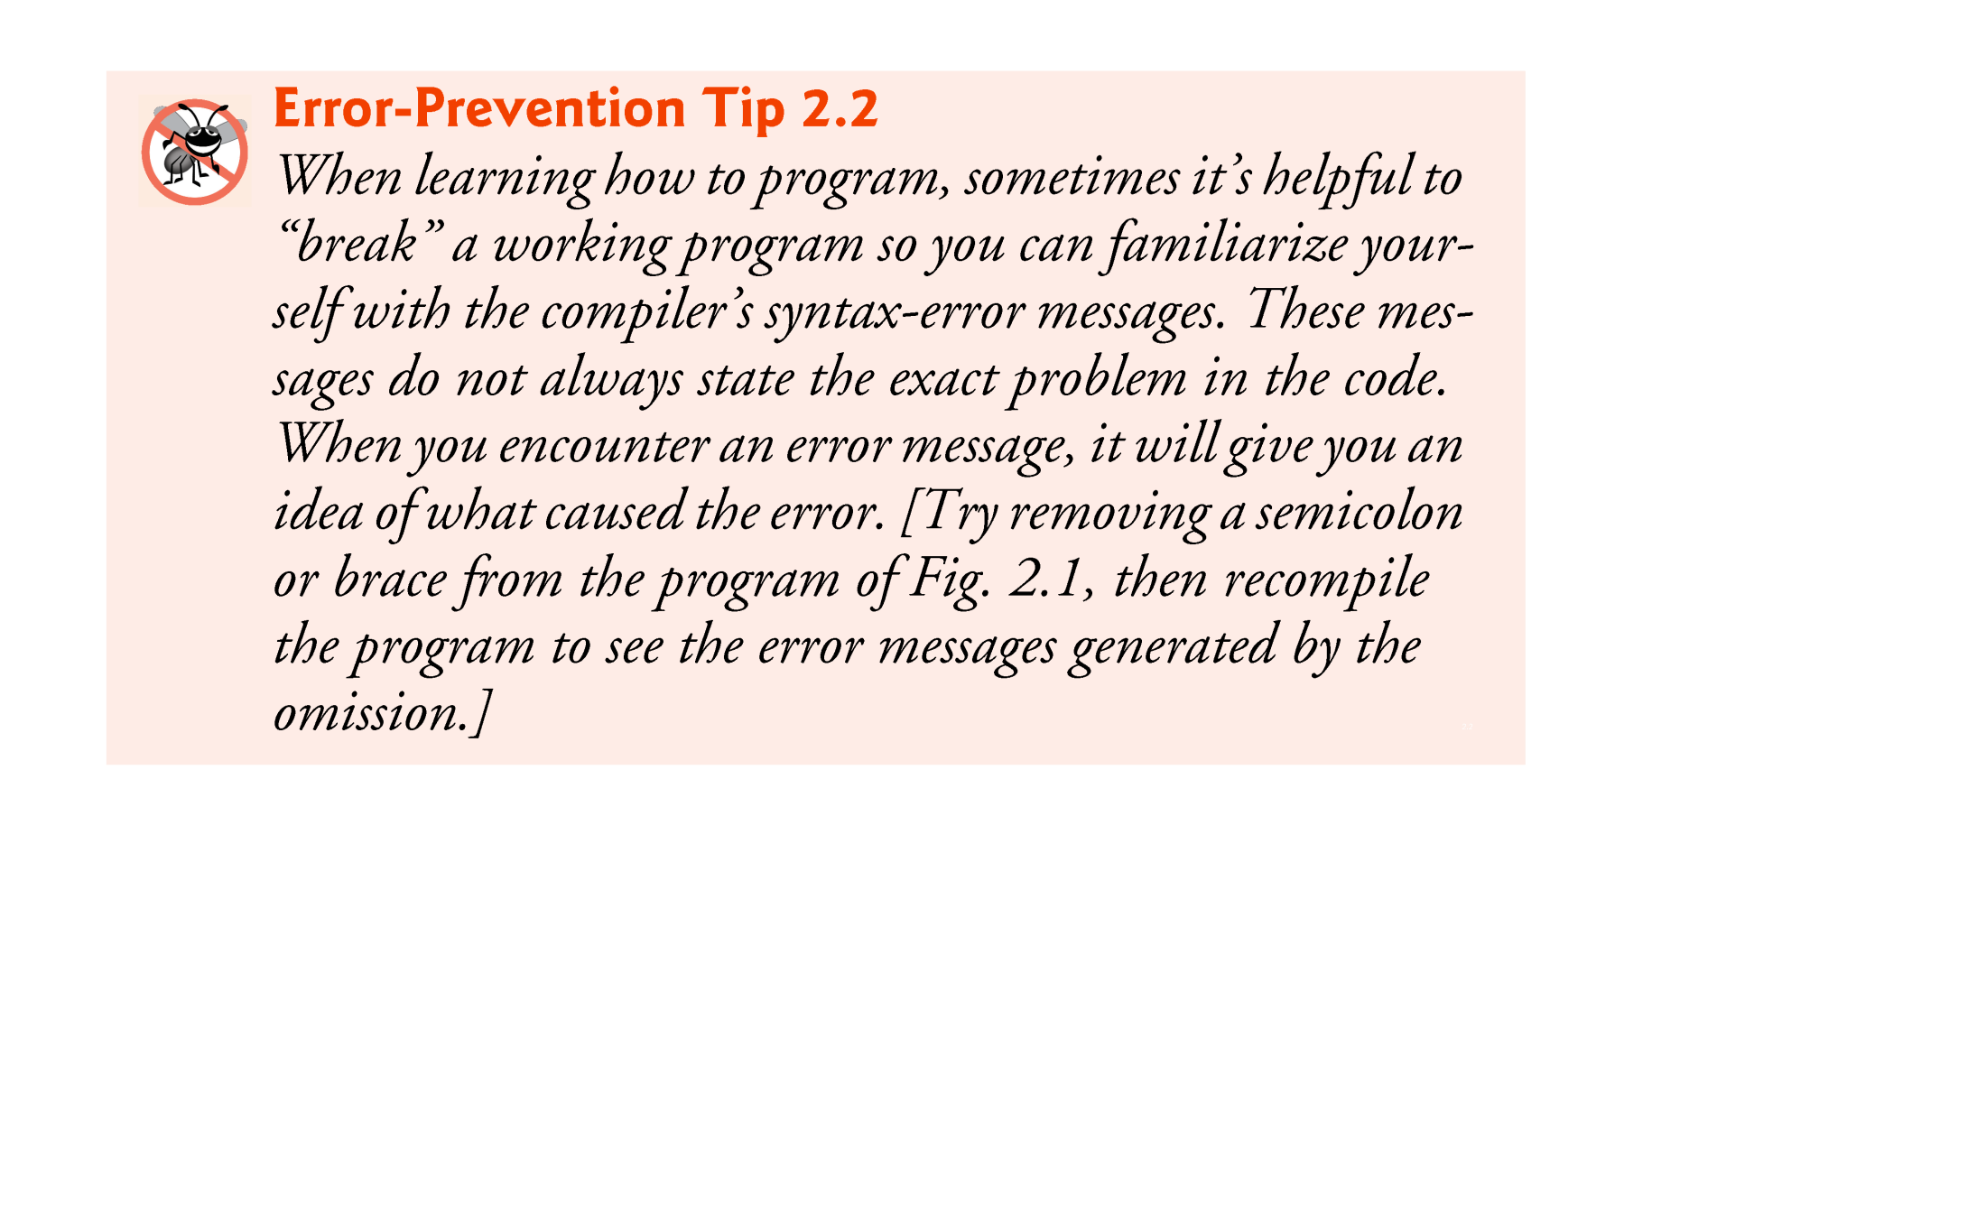

Slide 26
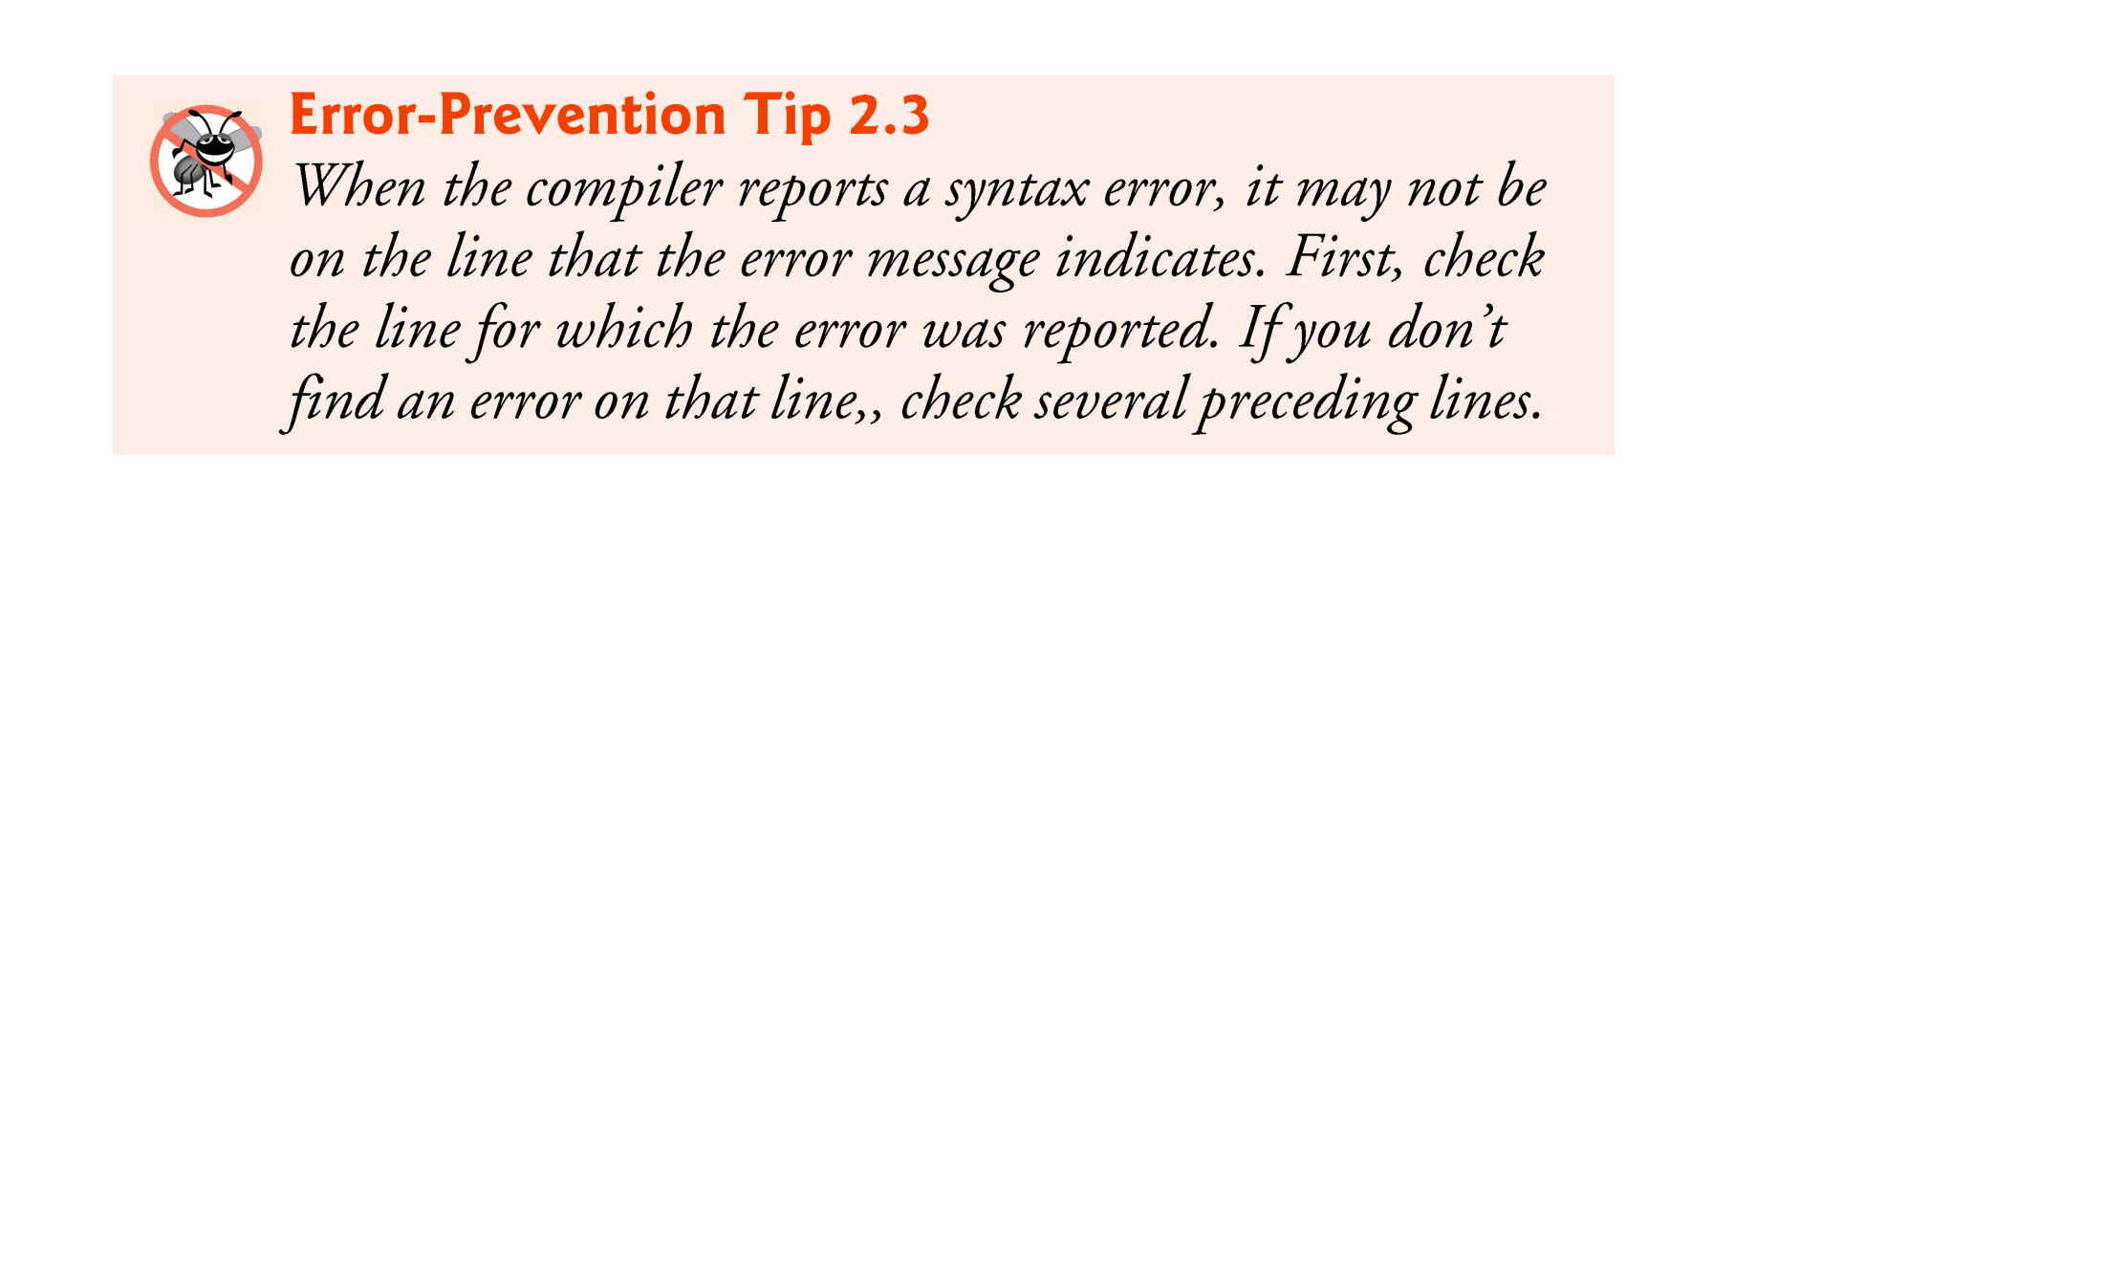

Slide 27
2.2 Our First Program in Java: Printing a Line of Text (Cont.)
Compiling and Executing Your First Java Application
Open a command window and change to the directory where the program is stored.
Many operating systems use the command cd to change directories.
To compile the program, type
javac Welcome1.java
If the program contains no syntax errors, preceding command creates a.class file (known as the class file) containing the platform-independent Java bytecodes that represent the application.
When we use the java command to execute the application on a given platform, these bytecodes will be translated by the JVM into instructions that are understood by the underlying operating system.

Slide 28
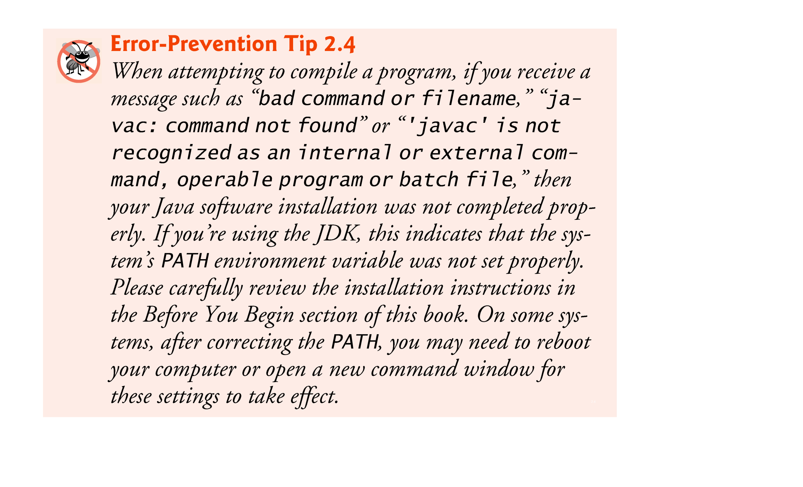

Slide 29
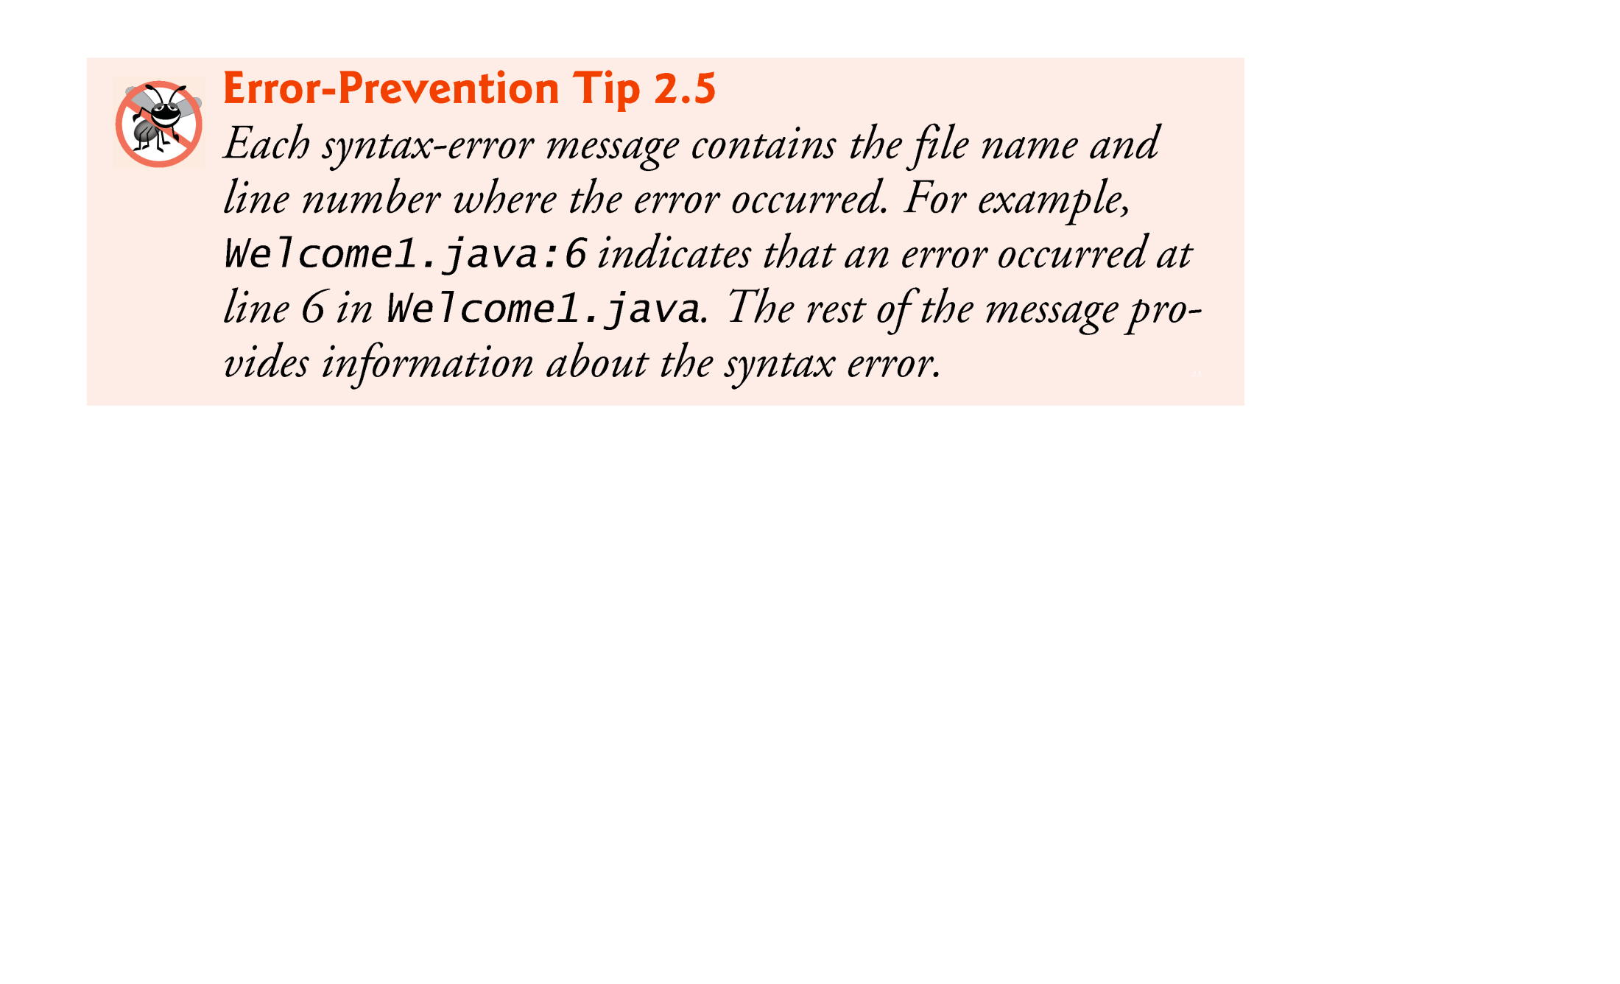

Slide 30
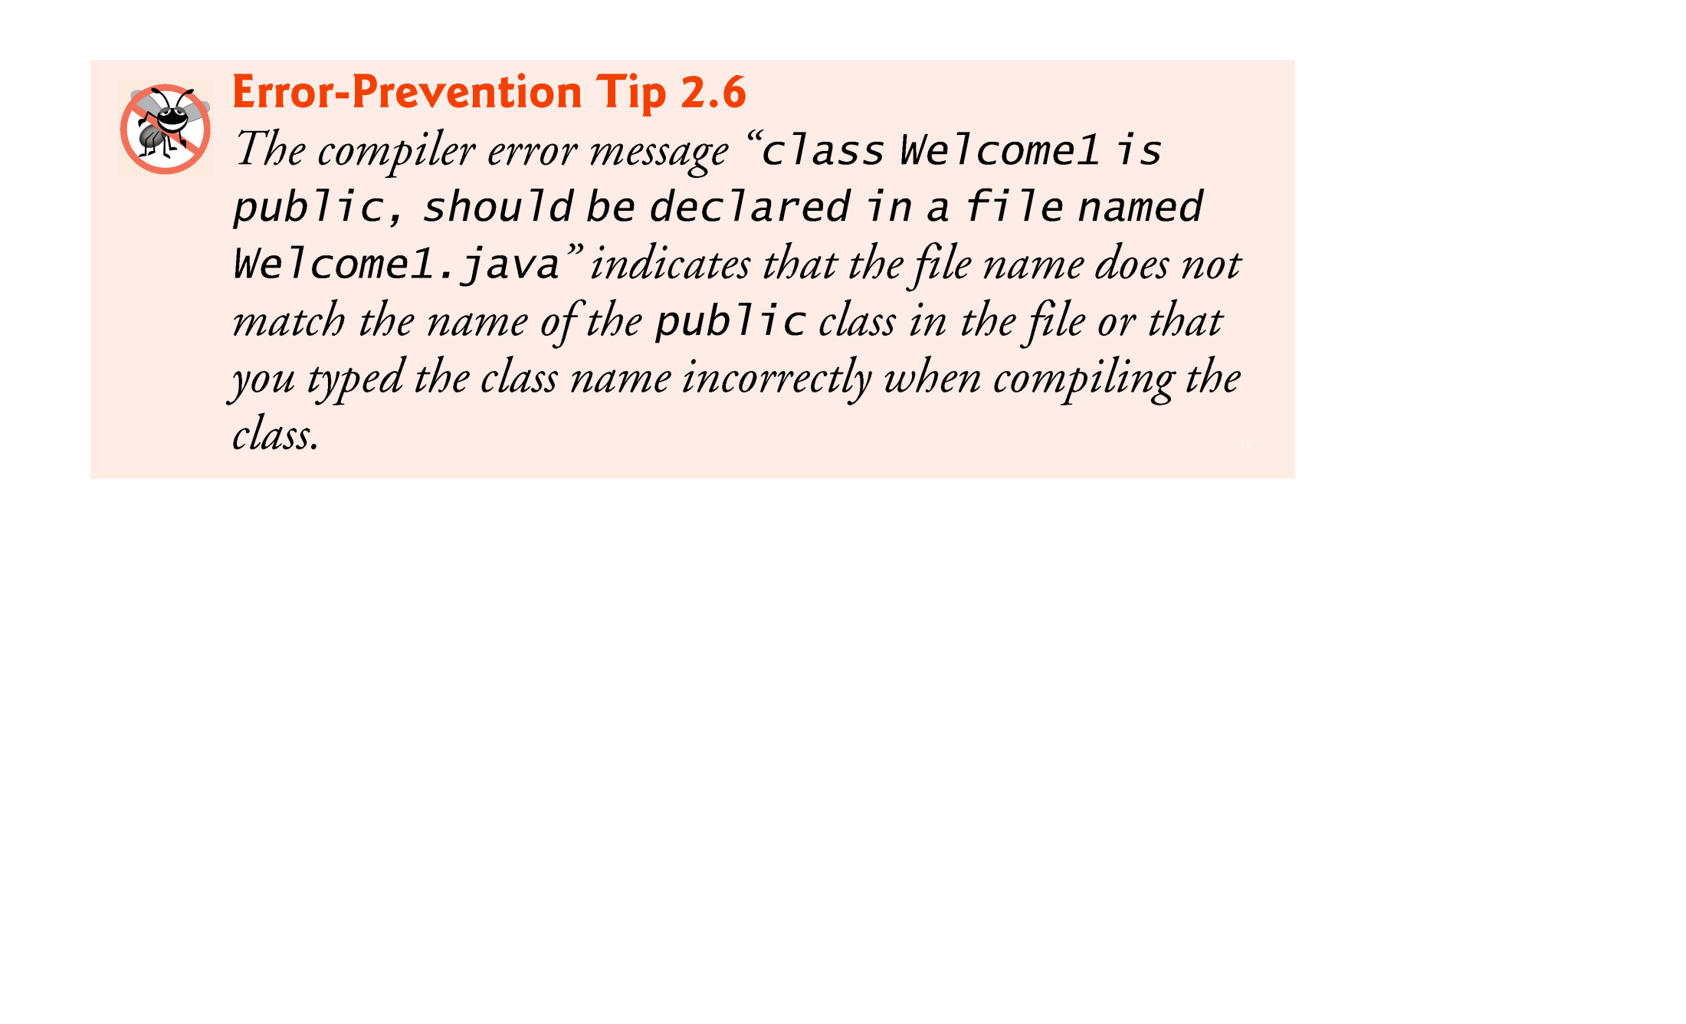

Slide 31
2.2 Our First Program in Java: Printing a Line of Text (Cont.)
To execute the program, type java Welcome1.
Launches the JVM, which loads the .class file for class Welcome1.
Note that the .class file-name extension is omitted from the preceding command; otherwise, the JVM will not execute the program.
The JVM calls method main to execute the program.

Slide 32
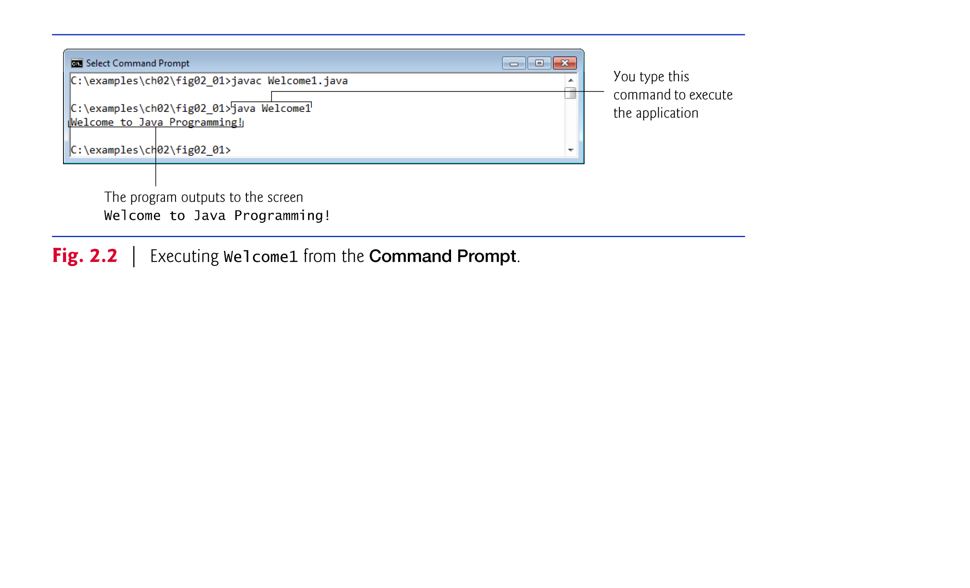

Slide 33
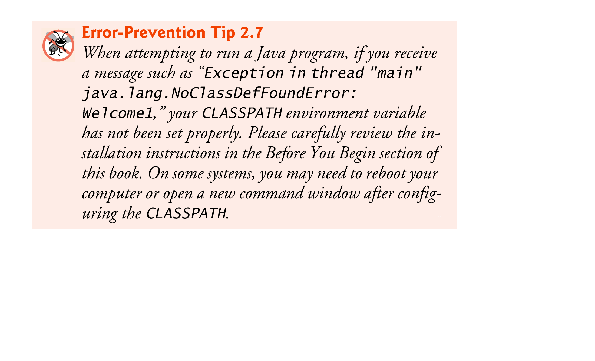

Slide 34
2.3 Modifying Your First Java Program
Class Welcome2, shown in Fig. 2.3, uses two statements to produce the same output as that shown in Fig. 2.1.
New and key features in each code listing are highlighted.
System.out’s method print displays a string.
Unlike println, print does not position the output cursor at the beginning of the next line in the command window.
The next character the program displays will appear immediately after the last character that print displays.

Slide 35
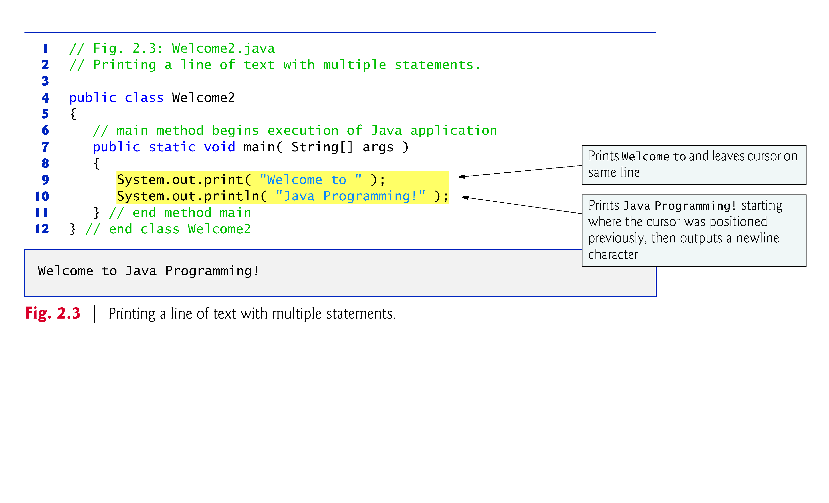

Slide 36
2.3 Modifying Your First Java Program (Cont.)
Newline characters indicate to System.out’s print and println methods when to position the output cursor at the beginning of the next line in the command window.
Newline characters are white-space characters.
The backslash (\) is called an escape character.
Indicates a “special character”
Backslash is combined with the next character to form an escape sequence.
The escape sequence \n represents the newline character.
Complete list of escape sequences
java.sun.com/docs/books/jls/third_edition/html/ lexical.html#3.10.6.

Slide 37
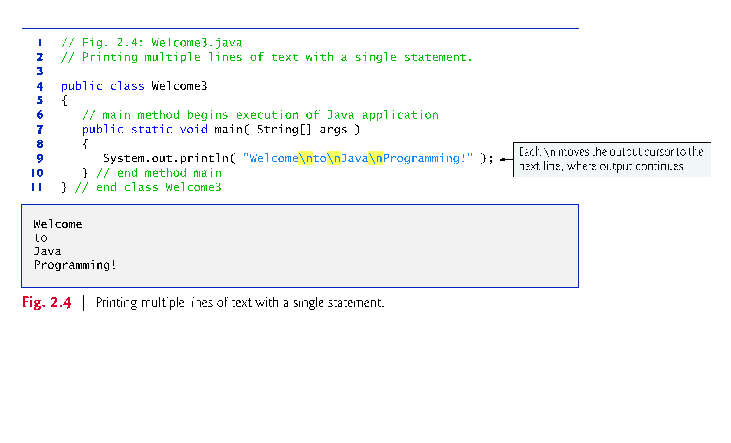

Slide 38
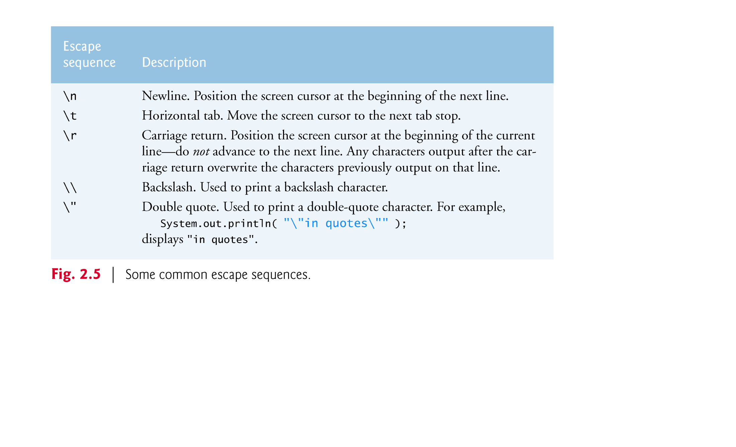

Slide 39
2.4 Displaying Text with printf
System.out.printf method
f means “formatted”
displays formatted data
Multiple method arguments are placed in a comma-separated list.
Java allows large statements to be split over many lines.
Cannot split a statement in the middle of an identifier or string.
Method printf’s first argument is a format string
May consist of fixed text and format specifiers.
Fixed text is output as it would be by print or println.
Each format specifier is a placeholder for a value and specifies the type of data to output.
Format specifiers begin with a percent sign (%) and are followed by a character that represents the data type.
Format specifier %s is a placeholder for a string.

Slide 40


Slide 41
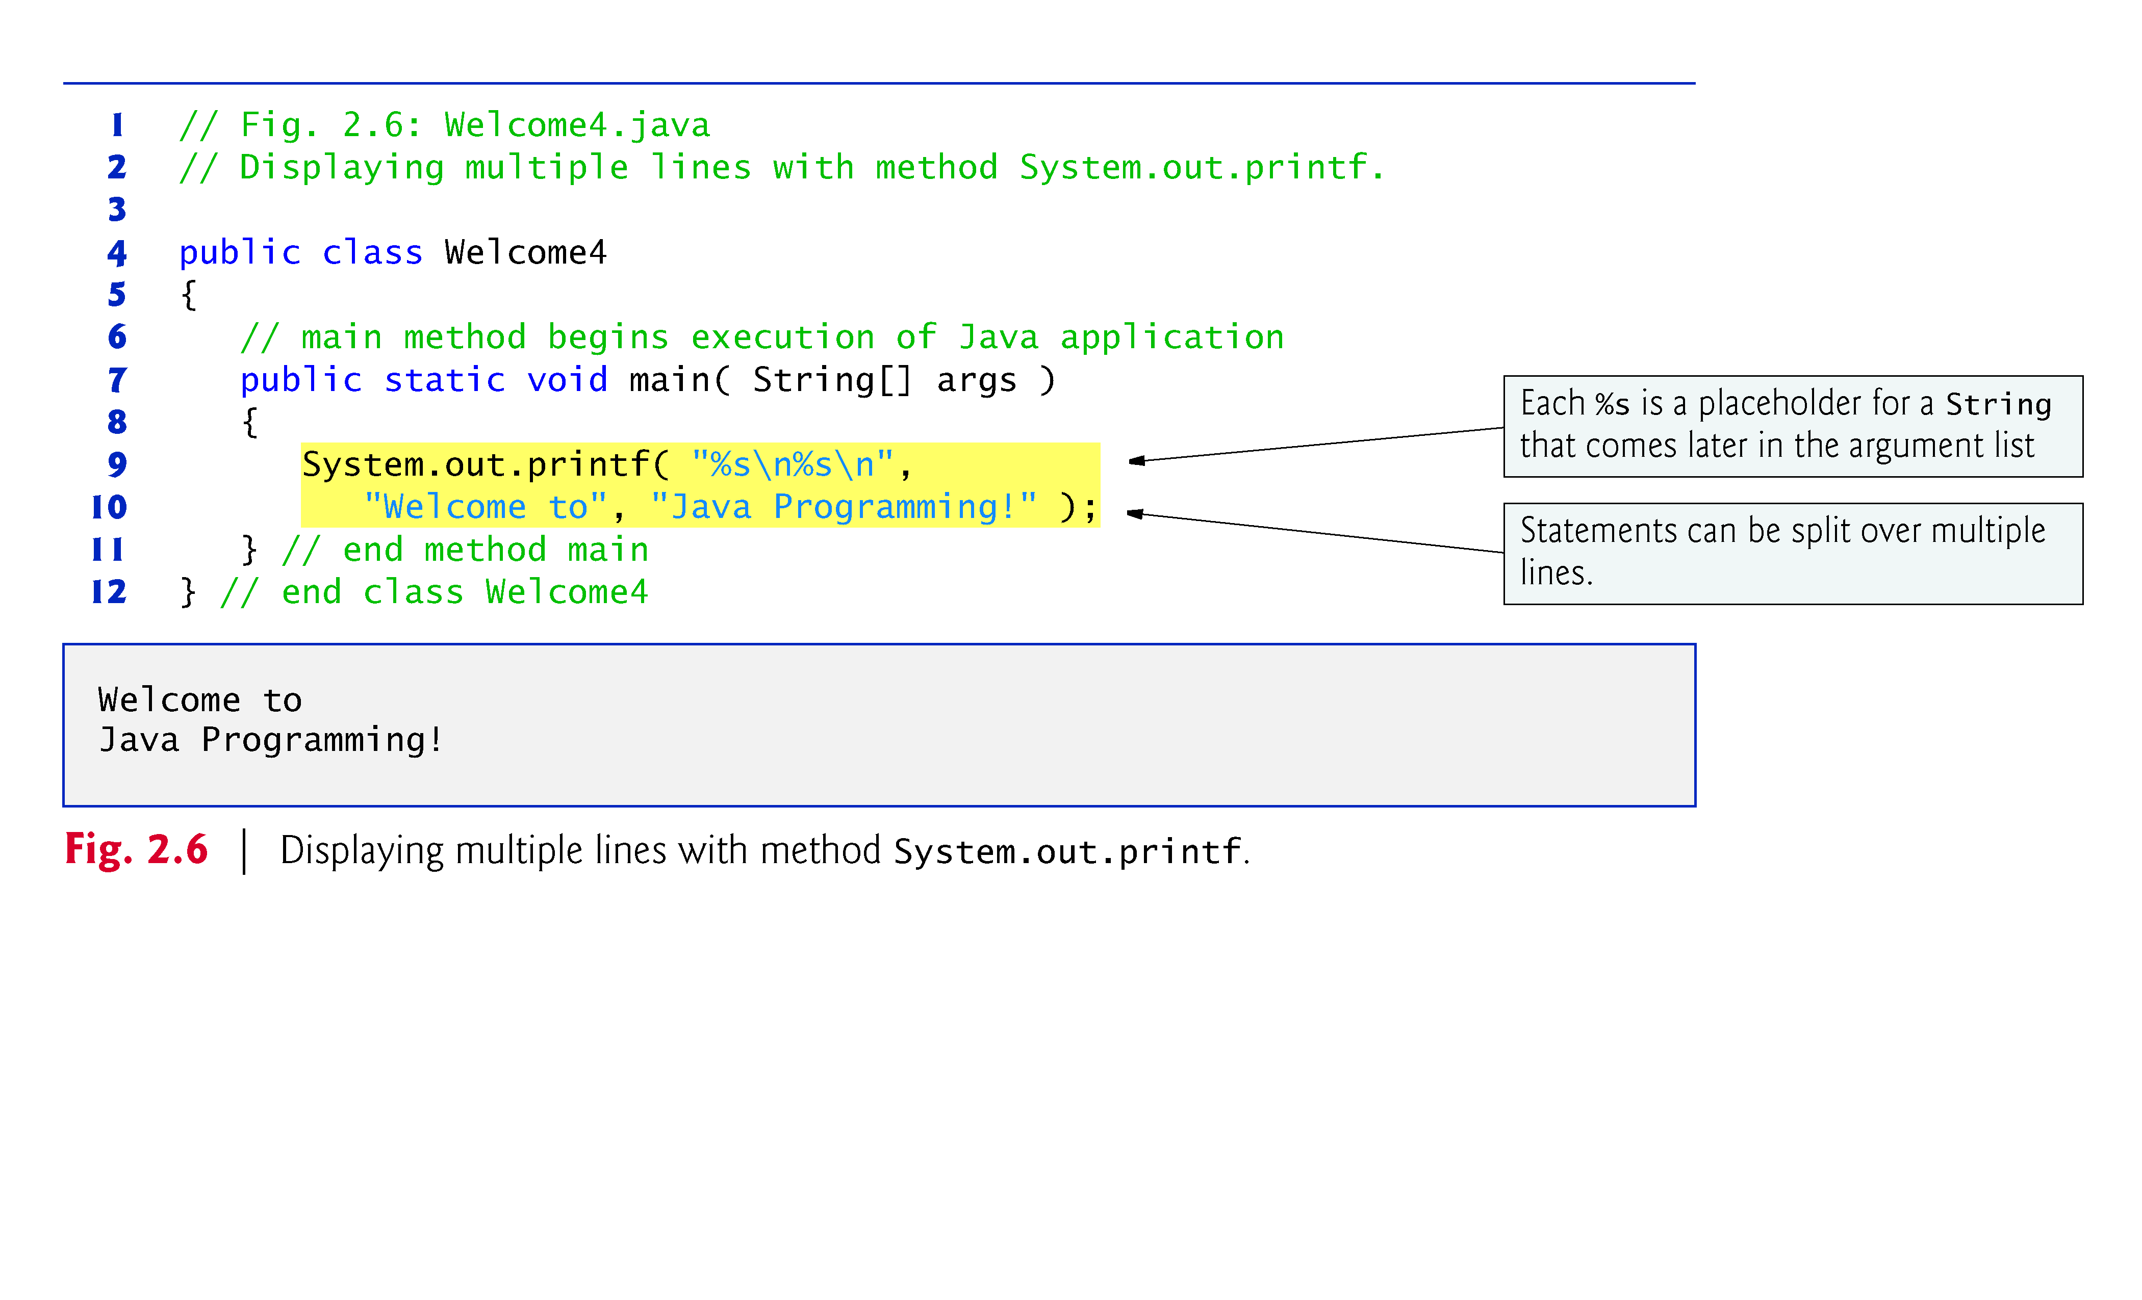

Slide 42


Slide 43
2.5 Another Application: Adding Integers
Integers
Whole numbers, like –22, 7, 0 and 1024)
Programs remember numbers and other data in the computer’s memory and access that data through program elements called variables.
The program of Fig. 2.7 demonstrates these concepts.

Slide 44
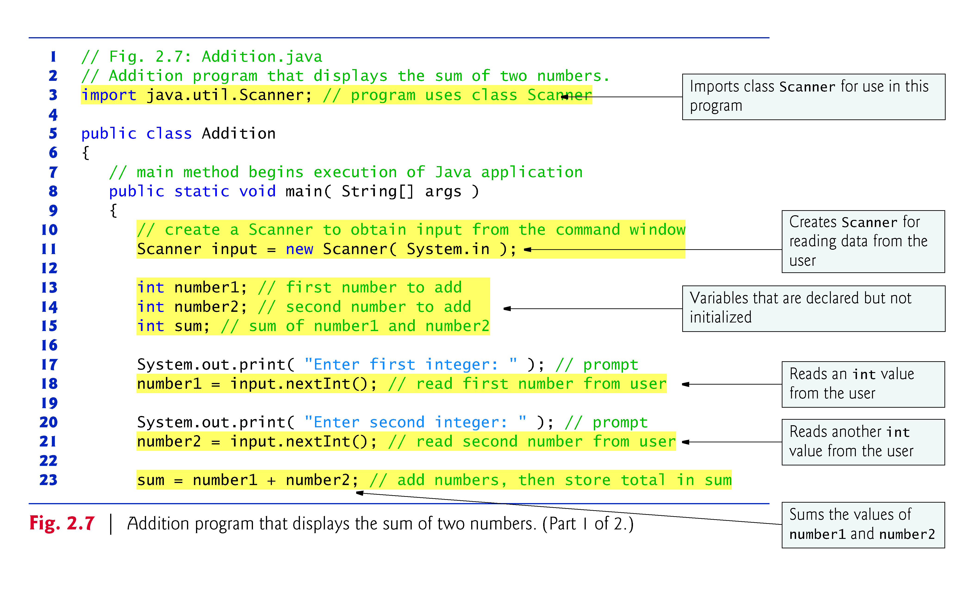

Slide 45
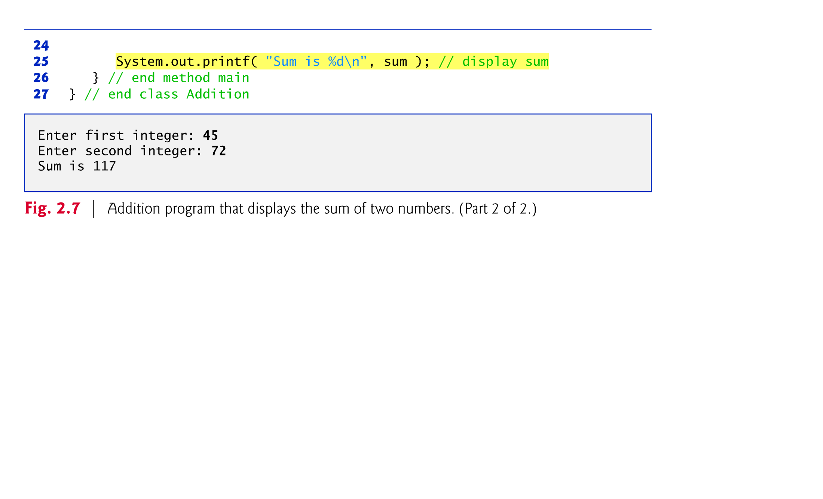

Slide 46
2.5 Another Application: Adding Integers (Cont.)
import declaration
Helps the compiler locate a class that is used in this program.
Rich set of predefined classes that you can reuse rather than “reinventing the wheel.”
Classes are grouped into packages—named groups of related classes—and are collectively referred to as the Java class library, or the Java Application Programming Interface (Java API).
You use import declarations to identify the predefined classes used in a Java program.

Slide 47
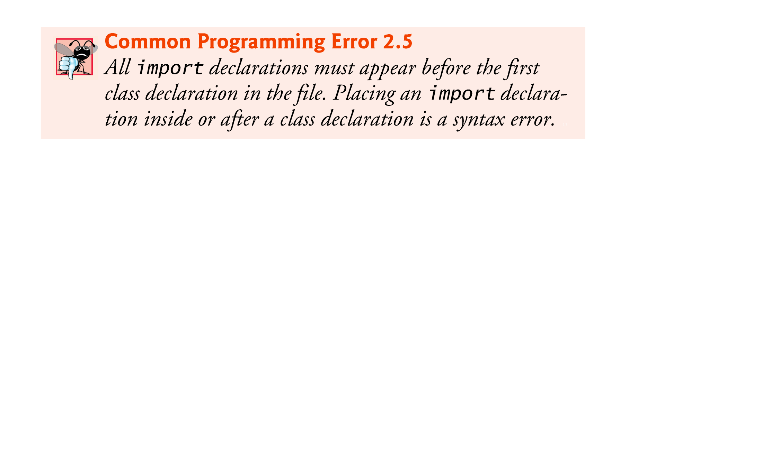

Slide 48
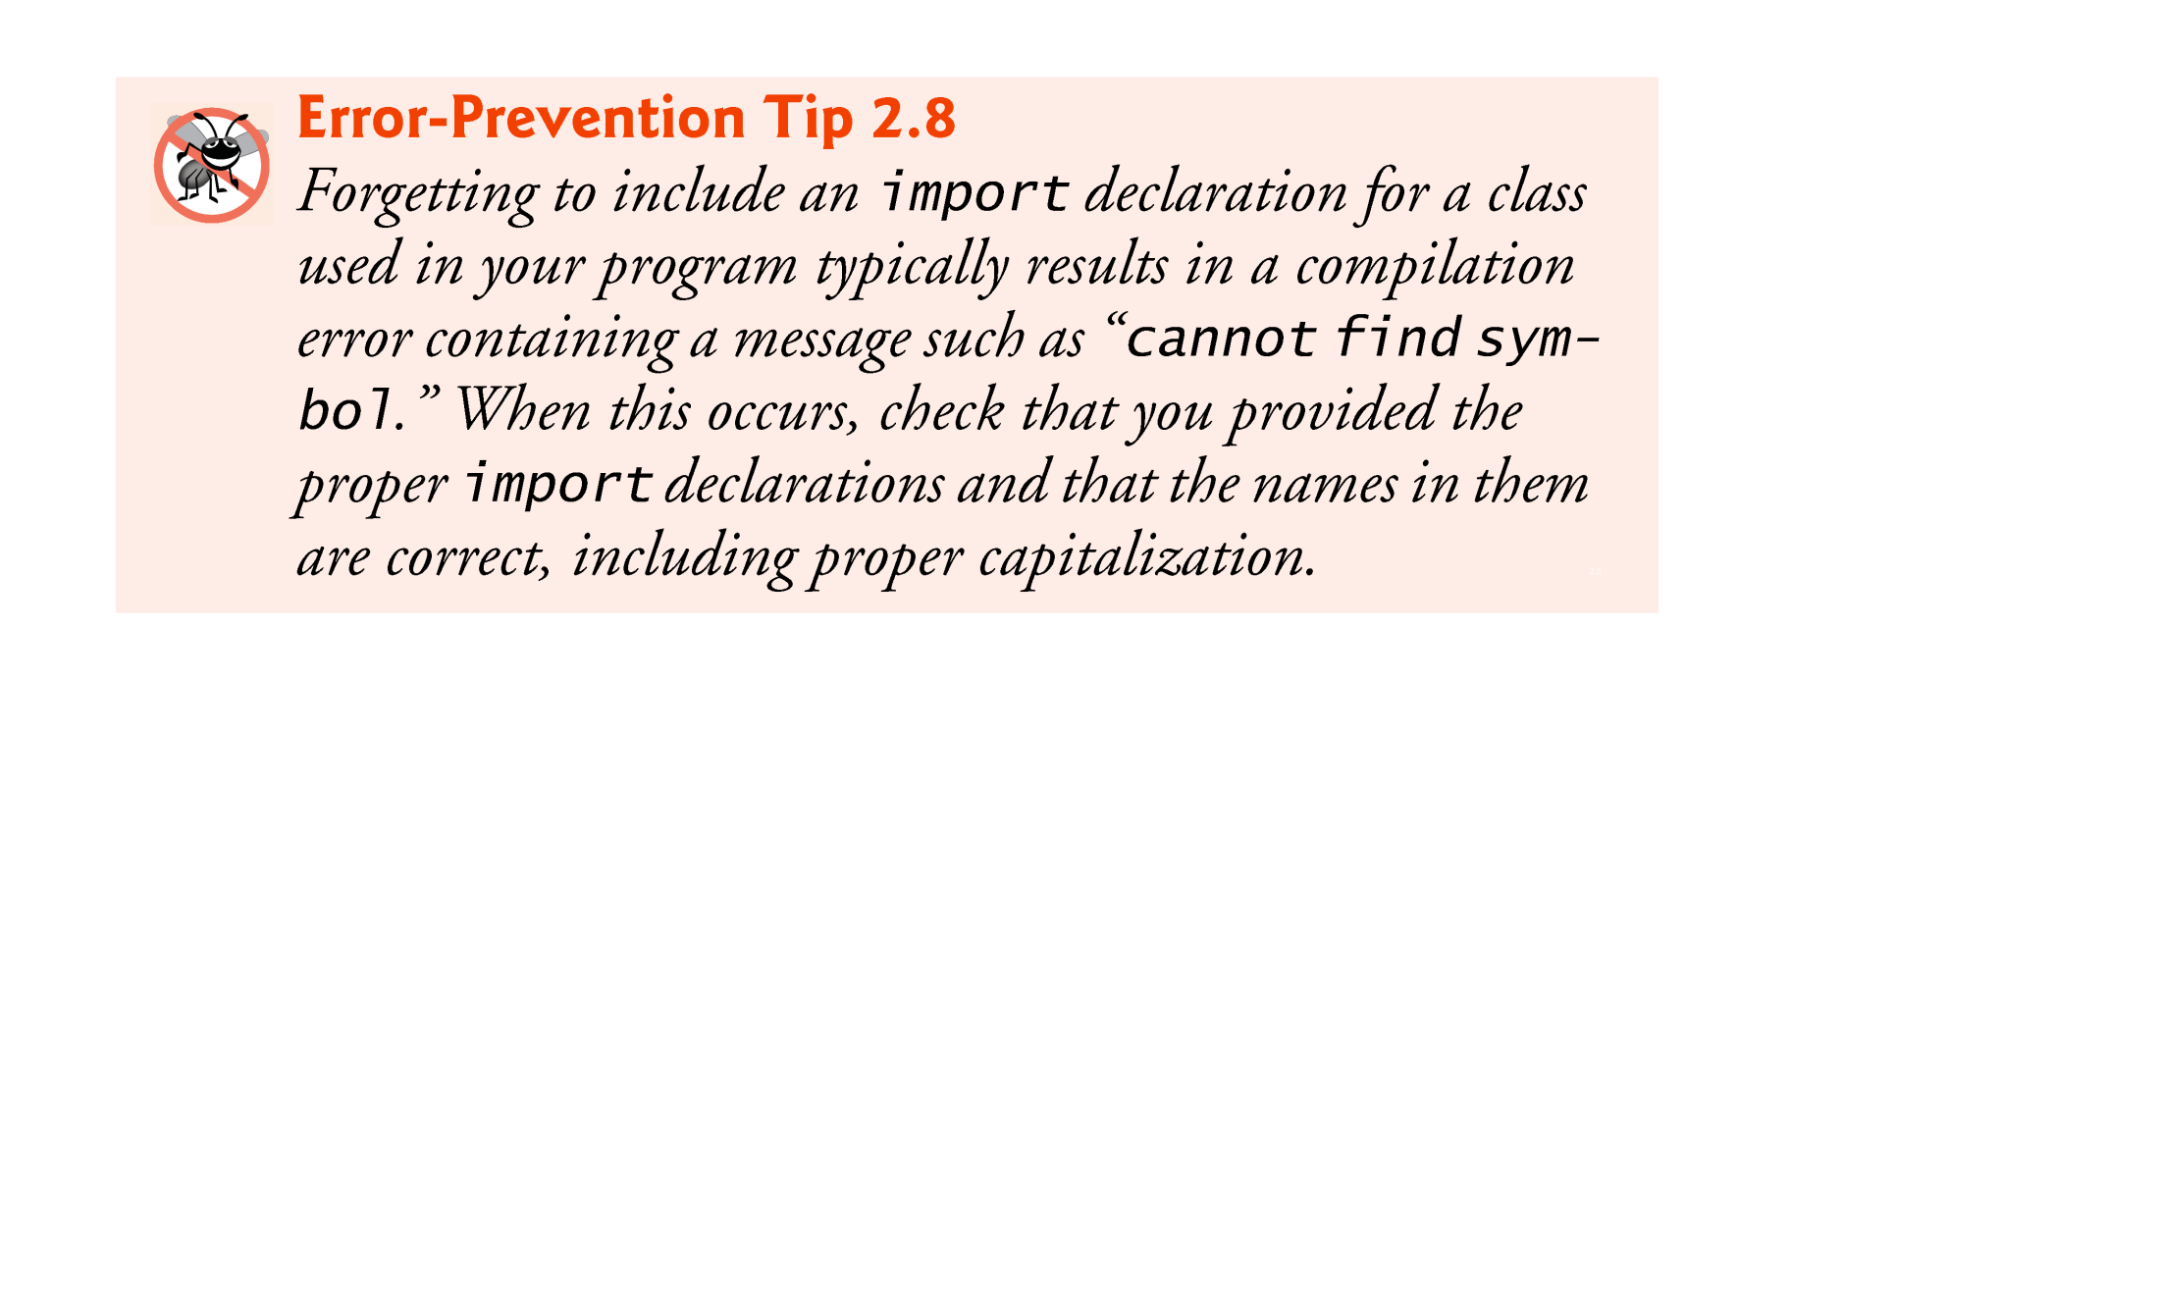

Slide 49
2.5 Another Application: Adding Integers (Cont.)
Variable declaration statement
Scanner input = new Scanner( System.in );
Specifies the name (input) and type (Scanner) of a variable that is used in this program.
Variable
A location in the computer’s memory where a value can be stored for use later in a program.
Must be declared with a name and a type before they can be used.
A variable’s name enables the program to access the value of the variable in memory.
The name can be any valid identifier.
A variable’s type specifies what kind of information is stored at that location in memory.

Slide 50
2.5 Another Application: Adding Integers (Cont.)
Scanner
Enables a program to read data for use in a program.
Data can come from many sources, such as the user at the keyboard or a file on disk.
Before using a Scanner, you must create it and specify the source of the data.
The equals sign (=) in a declaration indicates that the variable should be initialized (i.e., prepared for use in the program) with the result of the expression to the right of the equals sign.
The new keyword creates an object.
Standard input object, System.in, enables applications to read bytes of information typed by the user.
Scanner object translates these bytes into types that can be used in a program.

Slide 51
2.5 Another Application: Adding Integers (Cont.)
Variable declaration statements
int number1; // first number to add int number2; // second number to add int sum; // sum of number1 and number2
declare that variables number1, number2 and sum hold data of type int
They can hold integer.
Range of values for an int is –2,147,483,648 to +2,147,483,647.
Actual int values may not contain commas.
Several variables of the same type may be declared in one declaration with the variable names separated by commas.

Slide 52


Slide 53


Slide 54
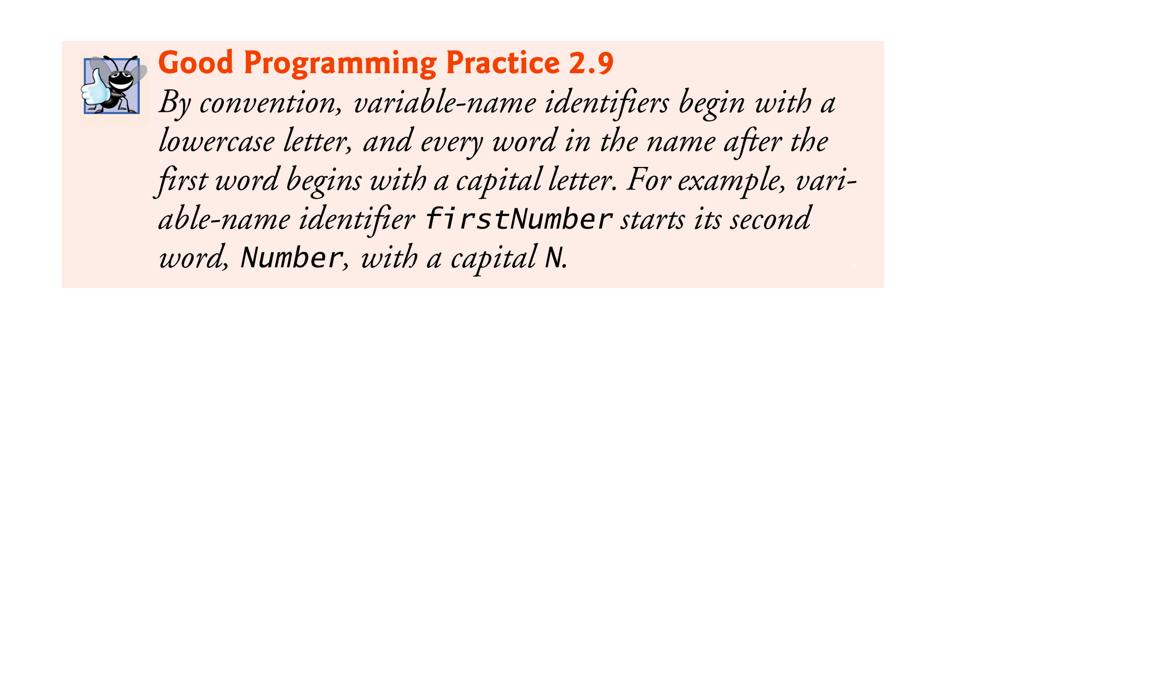

Slide 55
2.5 Another Application: Adding Integers (Cont.)
Prompt
Output statement that directs the user to take a specific action.
System is a class.
Part of package java.lang.
Class System is not imported with an import declaration at the beginning of the program.

Slide 56
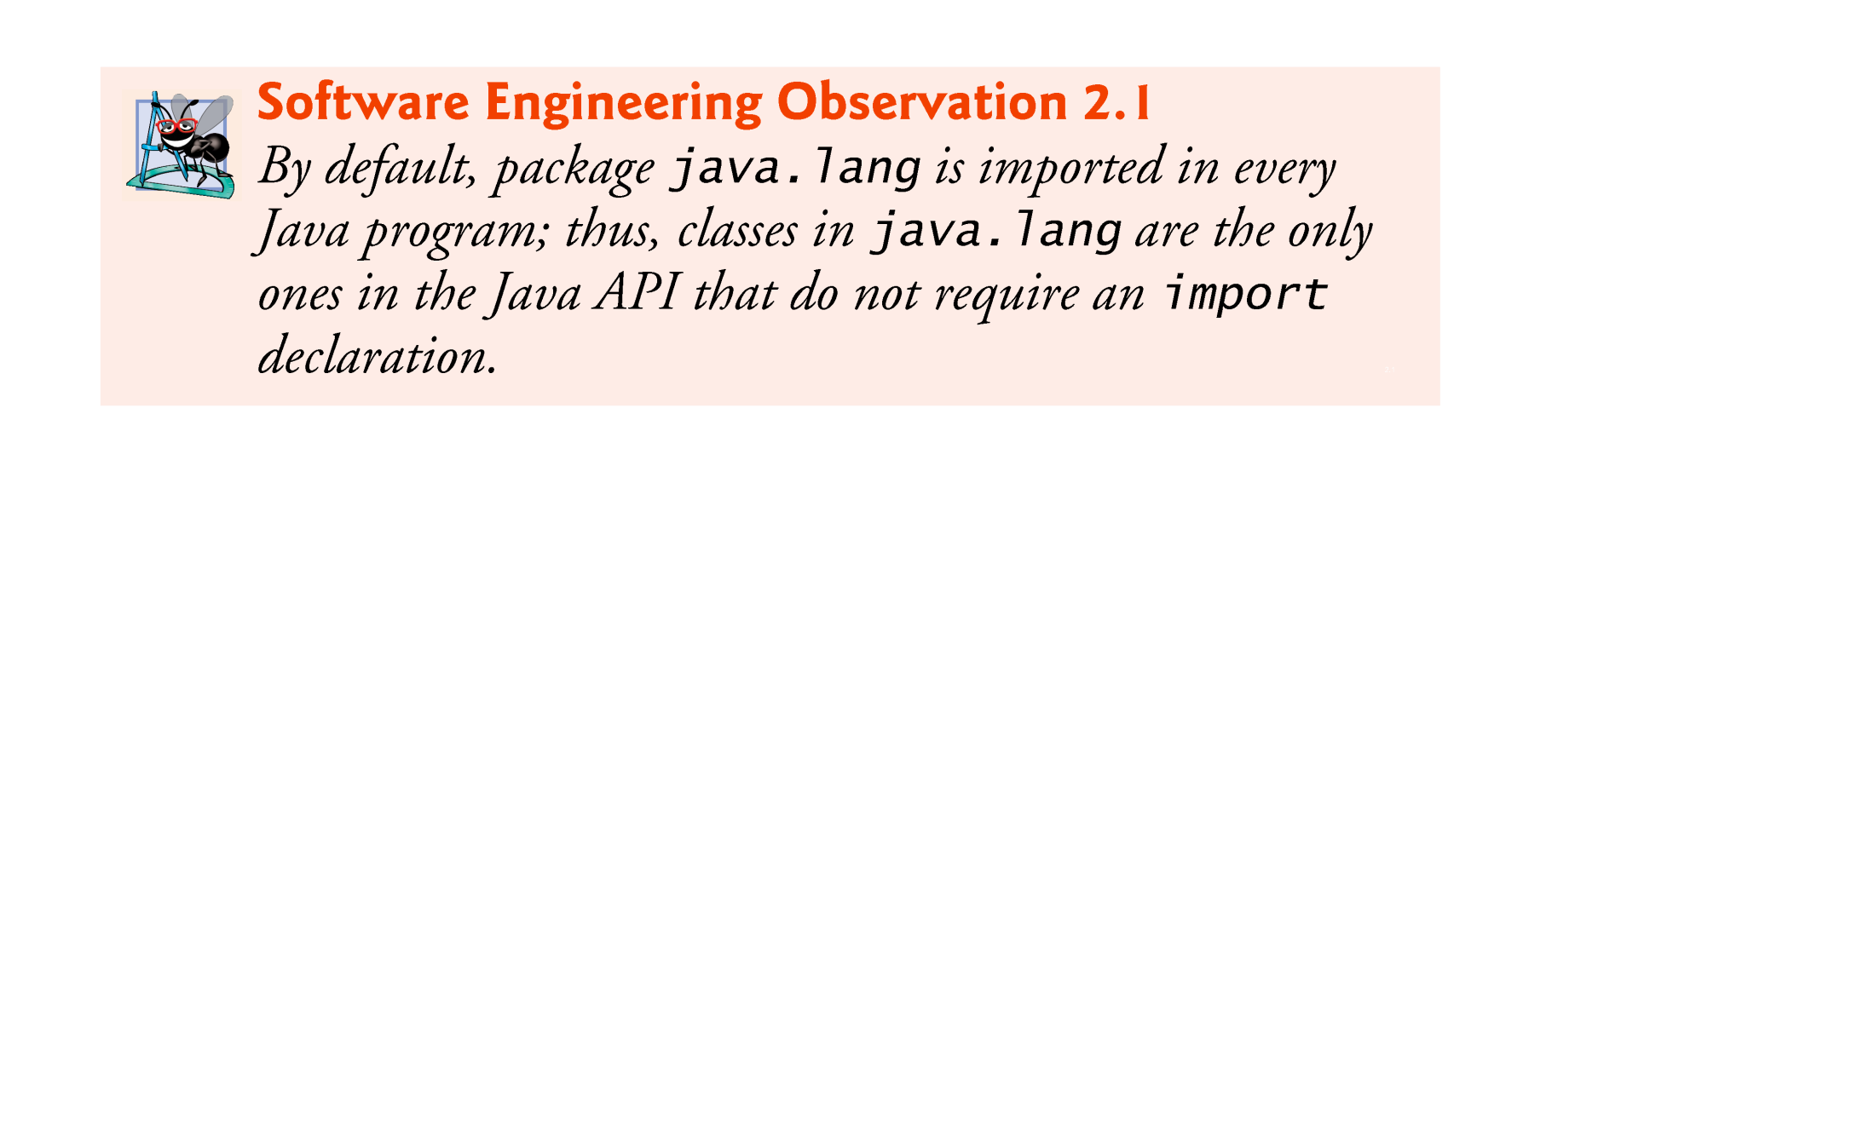

Slide 57
2.5 Another Application: Adding Integers (Cont.)
Scanner method nextInt
number1 = input.nextInt(); // read first number from user
Obtains an integer from the user at the keyboard.
Program waits for the user to type the number and press the Enter key to submit the number to the program.
The result of the call to method nextInt is placed in variable number1 by using the assignment operator, =.
“number1 gets the value of input.nextInt().”
Operator = is called a binary operator—it has two operands.
Everything to the right of the assignment operator, =, is always evaluated before the assignment is performed.

Slide 58


Slide 59
2.5 Another Application: Adding Integers (Cont.)
Arithmetic
sum = number1 + number2; // add numbers
Assignment statement that calculates the sum of the variables number1 and number2 then assigns the result to variable sum by using the assignment operator, =.
“sum gets the value of number1 + number2.”
In general, calculations are performed in assignment statements.
Portions of statements that contain calculations are called expressions.
An expression is any portion of a statement that has a value associated with it.

Slide 60
2.5 Another Application: Adding Integers (Cont.)
Integer formatted output
System.out.printf( "Sum is %d\n", sum );
Format specifier %d is a placeholder for an int value
The letter d stands for “decimal integer.”

Slide 61
2.6 Memory Concepts
Variables
Every variable has a name, a type, a size (in bytes) and a value.
When a new value is placed into a variable, the new value replaces the previous value (if any)
The previous value is lost.

Slide 62
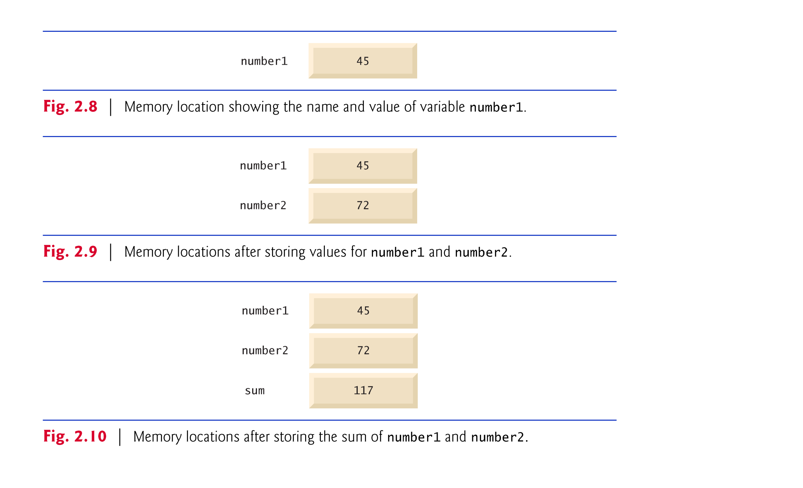

Slide 63
2.7 Arithmetic
Arithmetic operators are summarized in Fig. 2.11.
The asterisk (*) indicates multiplication
The percent sign (%) is the remainder operator
The arithmetic operators are binary operators because they each operate on two operands.
Integer division yields an integer quotient.
Any fractional part in integer division is simply discarded (i.e., truncated)—no rounding occurs.
The remainder operator, %, yields the remainder after division.

Slide 64
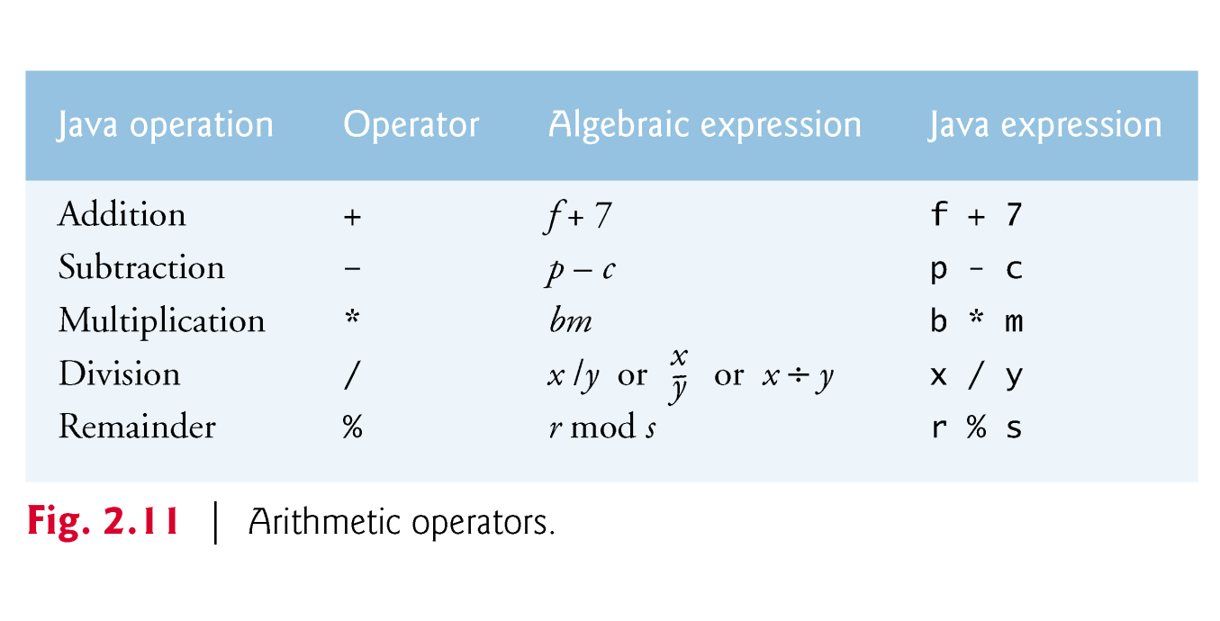

Slide 65
2.7 Arithmetic (Cont.)
Arithmetic expressions in Java must be written in straight-line form to facilitate entering programs into the computer.
Expressions such as “a divided by b” must be written as a / b, so that all constants, variables and operators appear in a straight line.
Parentheses are used to group terms in expressions in the same manner as in algebraic expressions.
If an expression contains nested parentheses, the expression in the innermost set of parentheses is evaluated first.

Slide 66
2.7 Arithmetic (Cont.)
Rules of operator precedence
Multiplication, division and remainder operations are applied first.
If an expression contains several such operations, they are applied from left to right.
Multiplication, division and remainder operators have the same level of precedence.
Addition and subtraction operations are applied next.
If an expression contains several such operations, the operators are applied from left to right.
Addition and subtraction operators have the same level of precedence.
When we say that operators are applied from left to right, we are referring to their associativity.
Some operators associate from right to left.
Complete precedence chart is included in Appendix A.

Slide 67
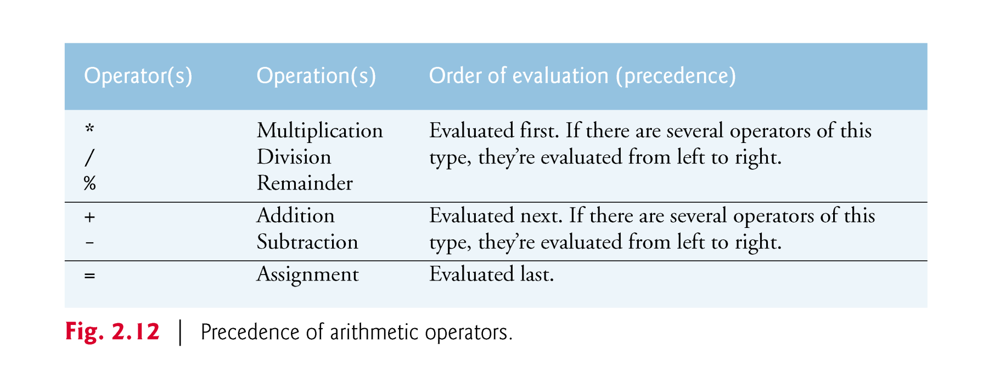

Slide 68
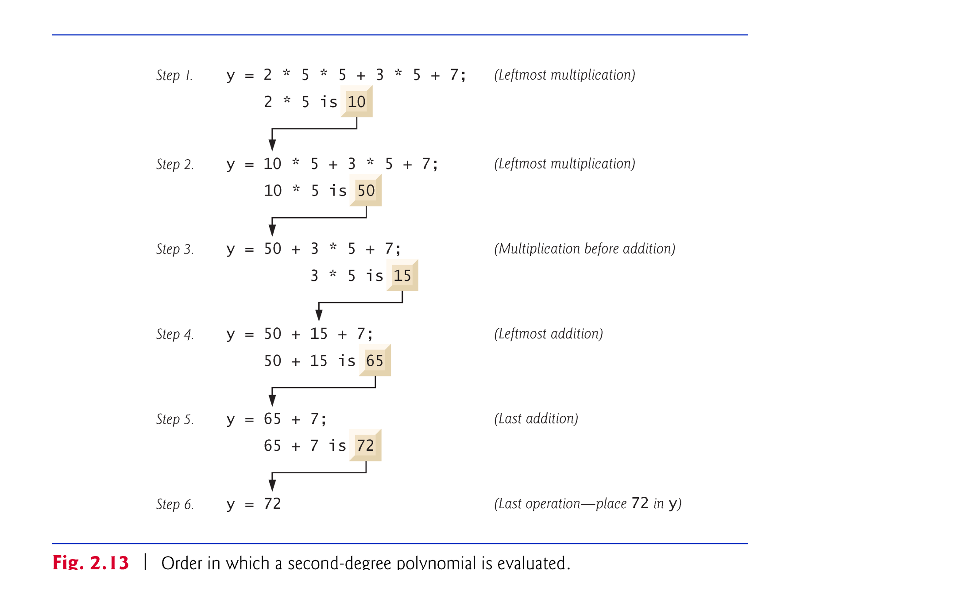

Slide 69
2.7 Arithmetic (Cont.)
As in algebra, it’s acceptable to place redundant parentheses (unnecessary parentheses) in an ex-pression to make the expression clearer.

Slide 70
2.8 Decision Making: Equality and Relational Operators
Condition
An expression that can be true or false.
if selection statement
Allows a program to make a decision based on a condition’s value.
Equality operators (== and !=)
Relational operators (>, <, >= and <=)
Both equality operators have the same level of precedence, which is lower than that of the relational operators.
The equality operators associate from left to right.
The relational operators all have the same level of precedence and also associate from left to right.

